Slide 1
Unit 6: Graphics, Files, Applets, and Swing
Lesson 19: Simple Two- Dimensional Graphics
Lesson 20: Files
Lesson 21: Introduction to HTML and Applets
Lesson 22: Swing and AWT

Slide 2
Lesson 19: Simple Two-Dimensional Graphics

Slide 3
Lesson 19: Simple Two-Dimensional Graphics
Objectives:
Understand the difference between Cartesian coordinates and screen coordinates.
Use methods to draw images in two-dimensional graphics.
Understand the transient image problem and how to solve it.
Implement methods to handle mouse events.
Work with color and text properties.

Slide 4
Lesson 19: Simple Two-Dimensional Graphics
Vocabulary:
coordinate system
c-curve
fractal object
fractals
graphics context
horizontal bar graph
line graphs
origin
paint mode
panel
refreshable image
screen coordinate system
transient image problem
vertical bar graph
XOR mode

Slide 5
19.1 The Conceptual Framework of Computer Graphics
Underlying every graphics application is a coordinate system.
Positions in this system are specified in terms of points.
Points in a two-dimensional system have x and y coordinates.
The x and y coordinates of a point express its position relative to the system's origin at (0, 0).
Figure 19-1 presents some examples of points in the familiar Cartesian coordinate system.

Slide 6
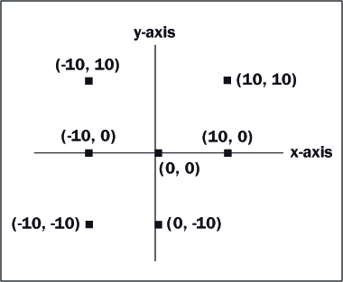
19.1 The Conceptual Framework of Computer Graphics

Slide 7
19.1 The Conceptual Framework of Computer Graphics
In Java and most other programming languages, the coordinate system is oriented as in Figure 19-2.
Note that the only quadrant shown is the one that defines the coordinates of the computer’s screen.
The other three quadrants exist, but the points in them never appear on the screen.
This is called a screen coordinate system.

Slide 8
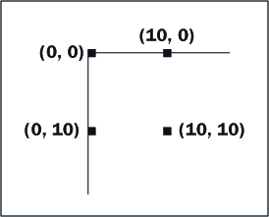
19.1 The Conceptual Framework of Computer Graphics
Orientation of Java’s coordinate system:

Slide 9
19.1 The Conceptual Framework of Computer Graphics
You can also create rectangular regions within a window called panels.
Each panel has its own coordinate system that is similar in form to the window's coordinate system.
Java programmers usually draw images on panels and almost never on the window itself.

Slide 10
19.1 The Conceptual Framework of Computer Graphics
The Graphics Class
The package java.awt provides a Graphics class for drawing in a panel.
A panel maintains an instance of this class, called a graphics context, so that the program can access and modify the panel's bitmap.
Some commonly used Graphics drawing methods are listed in Table 19-1.
The table also shows the results of running these methods in a window that has a single panel.

Slide 11
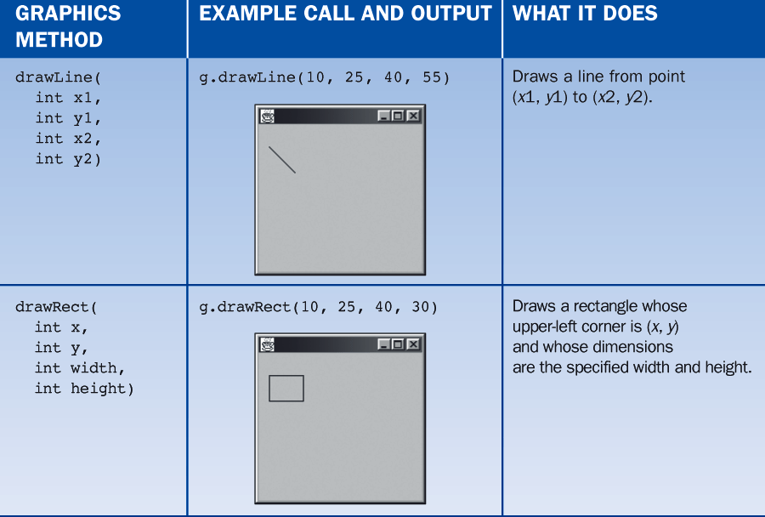
19.1 The Conceptual Framework of Computer Graphics

Slide 12
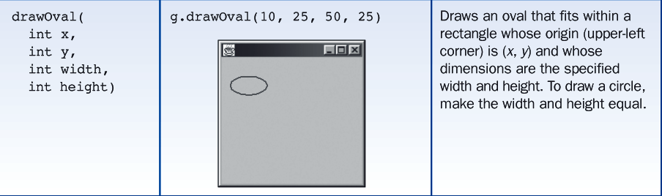
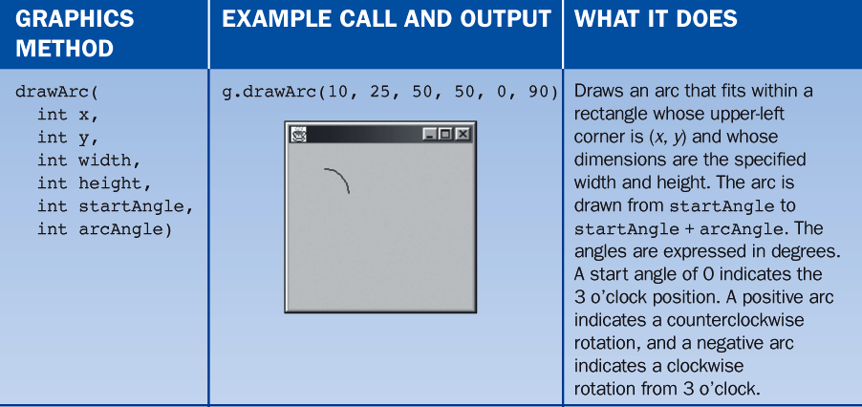
19.1 The Conceptual Framework of Computer Graphics

Slide 13
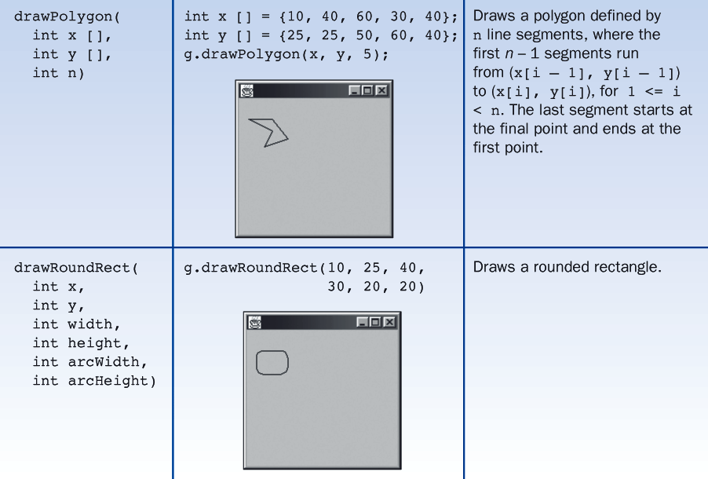
19.1 The Conceptual Framework of Computer Graphics

Slide 14
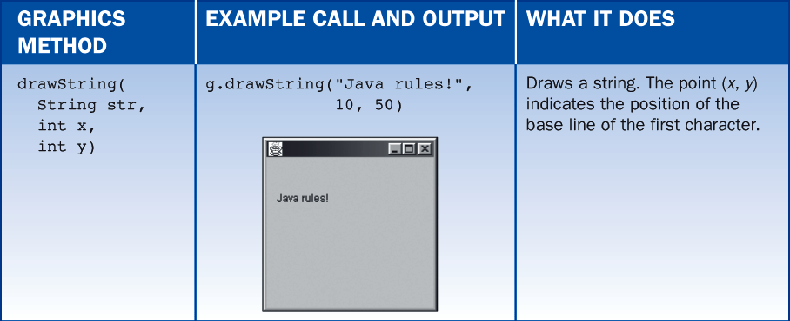
19.1 The Conceptual Framework of Computer Graphics
There are also the methods fillArc, fillRect, and fillOval, which draw filled shapes.

Slide 15
19.1 The Conceptual Framework of Computer Graphics
Adding a Panel to a Window
BreezySwing provides the class GBPanel for defining panels.
To write a graphics application, one should do two things:
Define a subclass of GBPanel.
This class accesses the graphics context to create the drawing.
The panel can draw images "on its own" or in response to messages sent to it from the main window
Create an instance of the panel class and add this object to the application's window.

Slide 16
19.1 The Conceptual Framework of Computer Graphics
Let us assume that someone has defined a panel class named ExamplePanel.
The following application adds an instance of this class to a window.

Slide 17
19.1 The Conceptual Framework of Computer Graphics
import BreezySwing.*;
public class GraphicsExamples extends GBFrame{
private GBPanel panel;
public GraphicsExamples(){
panel = addPanel(new ExamplePanel(), 1,1,1,1);
}
public static void main (String[] args){
GraphicsExamples theGUI = new GraphicsExamples();
theGUI.setSize (200, 200);
theGUI.setVisible(true);
}
}

Slide 18
19.1 The Conceptual Framework of Computer Graphics
The form of the method for adding a panel to a window is:
More often than not, we will use code such as:
This code provides a variable of the specific panel type so that messages can be sent to it without casting.
<variable name> = addPanel(<panel object>,
<row>, <col>, <width>, height>);
private ExamplePanel panel;
private GBPanel p;
public SomeConstructor(){
panel = new ExamplePanel();
p = addPanel(panel, 1,1,1,1);
}

Slide 19
19.1 The Conceptual Framework of Computer Graphics
Implementing a Panel Class and the Method paintComponent
The responsibilities of a panel class are to draw images in response to messages from an application and also to redraw images whenever the window is refreshed.
When a window opens, the JVM sends the message paintComponent to each window object. If the object has any images to draw, its paintComponent method accomplishes this.
Following is the code for the implementation of the ExamplePanel class used earlier. Its paintComponent method draws a line segment when the window opens and whenever it is refreshed.

Slide 20
19.1 The Conceptual Framework of Computer Graphics
import BreezySwing.*; // Needed for GBPanel
import java.awt.*; // Needed for Graphics
public class ExamplePanel extends GBPanel{
public void paintComponent (Graphics g){
super.paintComponent(g);
g.drawLine(10, 25, 40, 55);
}
}

Slide 21
19.1 The Conceptual Framework of Computer Graphics
The method first calls the same method in the superclass.
The reason is that the method in the superclass paints the background of the component.
This effectively clears any images in the panel before they are redrawn

Slide 22
19.1 The Conceptual Framework of Computer Graphics
The methods getWidth() and getHeight() return the current width and height of a panel, respectively.
The following code would maintain a display of a panel's current width and height near the center of the panel:
public void paintComponent (Graphics g){
super.paintComponent(g);
g.drawString("(" + getWidth() + "," + getHeight() + ")",
getWidth() / 2, getHeight() / 2);
}

Slide 23
19.2 The Method repaint
The method repaint is implemented in one of GBPanel's superclasses, first erases the current drawing in the panel and then calls paintComponent.
repaint is also implemented in one of GBFrame's superclasses.
When sent to a window rather than a panel it tells all the window objects (text fields, labels, buttons, panels, and so forth) to redisplay themselves.

Slide 24
19.3 The Method getGraphics
Suppose that you want to draw several images that remain in the panel.
The getGraphics() method allows the programmer to access a panel's graphics object to draw without repainting.
You use this method as follows:
Graphics g = getGraphics();
<send messages to g to draw images>

Slide 25
19.3 The Method getGraphics
The class ShapePanel can be modified to draw multiple shapes by:
omitting the method paintComponent
placing the code to draw a shape in the method drawShape, which uses getGraphics to access the graphics object
To clear the panel, drawShape calls repaint, which clears the panel and calls the paintComponent method in a superclass that does nothing.
Following is the code for the modified class:

Slide 26
19.3 The Method getGraphics
import BreezySwing.*;
import java.awt.*;
public class ShapePanel extends GBPanel{
// No instance variables are needed
// No paintComponent method is needed
// All drawing or clearing is done in drawShape
public void drawShape(String shape, int x, int y,
int width, int height){
Graphics g = getGraphics();
if (shape.equalsIgnoreCase("oval"))
g.drawOval(x, y, width, height);
else if (shape.equalsIgnoreCase("rectangle"))
g.drawRect(x, y, width, height);
else
repaint(); // Clear panel and call paintComponent
}
}

Slide 27
19.4 Color
A Java programmer can control the color of images by using the Color class.
The Color class is included in the package java.awt.
The Color class provides the class constants shown in Table 19-2.
The Graphics class includes two methods for examining and modifying an image's color (Table 19-3).

Slide 28
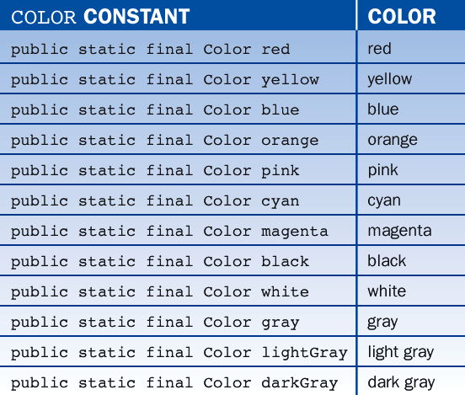
19.4 Color

Slide 29
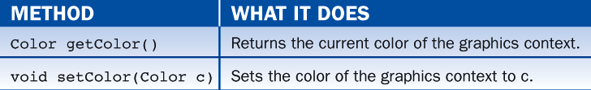
19.4 Color

Slide 30
19.4 Color
The following code segment draws a string in red and a line in blue in the graphics context g:
g.setColor (Color.red);
g.drawString ("Colors are great!", 50, 50);
g.setColor (Color.blue);
g.drawLine (50, 50, 150, 50);

Slide 31
19.4 Color
Java allows the programmer finer control over colors by using RGB (red/green/blue) values.
In this scheme, there are:
256 shades of red
256 shades of green
256 shades of blue
The programmer "mixes" a new color by selecting an integer from 0 to 255 for each color and passing these integers to a Color constructor as follows:
new Color (<int for red>, <int for green>, <int for blue>)

Slide 32
19.4 Color
The next code segment shows how to create a random color with RGB values:
// Create a random color from randomly generated RGB values
int r = (int) (Math.random() * 256);
int g = (int) (Math.random() * 256);
int b = (int) (Math.random() * 256);
Color randomColor = new Color (r, g, b);

Slide 33
19.4 Color
Setting a Panel's Background Color
A panel recognizes the message setBackGround(aColor), which changes its background color to the given color.
The following short program displays a 2 x 2 grid of panels of four different colors, as shown in Figure 19-4.

Slide 34
19.4 Color
import javax.swing.*;
import BreezySwing.*;
import java.awt.*;
public class TestPanel extends GBFrame{
private GBPanel northWest, southWest, northEast, southEast;
public TestPanel(){
northWest = addPanel(new GBPanel(), 1,1,1,1);
southWest = addPanel(new GBPanel(), 1,2,1,1);

Slide 35
19.4 Color
northEast = addPanel(new GBPanel(), 2,1,1,1);
southEast = addPanel(new GBPanel(), 2,2,1,1);
northWest.setBackground(Color.red);
southWest.setBackground(Color.green);
northEast.setBackground(Color.blue);
southEast.setBackground(Color.yellow);
}
public static void main (String[] args){
TestPanel theGUI = new TestPanel();
theGUI.setSize (200, 200);
theGUI.setVisible (true);
}
}

Slide 36
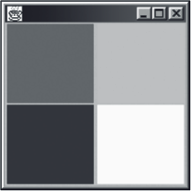
19.4 Color
Figure 19-4

Slide 37
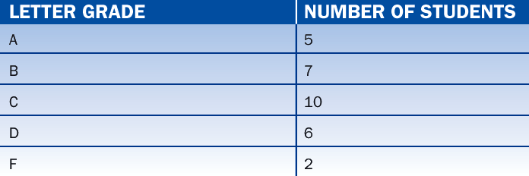
19.5 Graphing Data
Line Graphs
Line graphs are the easiest to conceptualize and implement.
The data to be plotted might be listed in a table.
For example, Table 19-4 lists the numbers of students receiving the letter grades A, B, C, D, and F in a class.

Slide 38
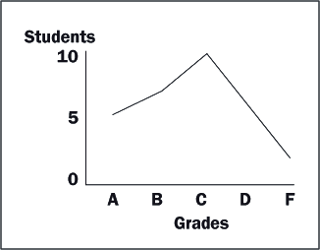
19.5 Graphing Data
A line graph of these data might look like the one in Figure 19-7:

Slide 39
19.5 Graphing Data
To construct this line graph, we did the following:
placed the letter grades along the x-axis
placed the numbers of these grades along the y-axis
drew a dot at the coordinates formed by each number/grade pair
connected these dots

Slide 40
19.5 Graphing Data
The major difficulty in drawing line graphs is figuring out the scale; that is:
the number of pixels that lie between each value on the x axis
the number of pixels that lie between each value on the y axis
The problem is solved by matching the range of values to the pixel dimensions of the graph.
Suppose we plot grades on a 200 pixel-wide graph.
Because there are five letter grades, there are 40 pixels between each value on the x-axis.

Slide 41
19.5 Graphing Data
The general formula for calculating this increment is:
x increment = width in pixels / number of values to plot
The increment for the y-axis is calculated as follows:
if largest value to plot on the y axis equals 0
y increment = 0
else
y increment = total y pixels / largest value to plot on the y axis

Slide 42
19.5 Graphing Data
We can define two methods that convert data values in the table to pixel coordinates.
The method getXCoordinate uses the position of the data value in the array (numbering from 1) and returns the x coordinate of the point to plot.
In the code that follows:
xIncrement is the number of pixels between data points on the x axis
i is a number from 1 to the number of values to plot, in this example, 5
X_LEFT is the x coordinate of the graph's origin

Slide 43
19.5 Graphing Data
The method getYCoordinate returns the y coordinate of the point to plot. In the code that follows:
yIncrement is the number of pixels per data unit
numStudents is the number of students being plotted at the current grade
Y_BOTTOM is the y coordinate in the window of the bottommost point on the y axis
private int getXCoordinate (int i, int xIncrement){
return X_LEFT + xIncrement * i;
}
private int getYCoordinate (int numStudents, int yIncrement){
return Y_BOTTOM - yIncrement * numStudents);
}

Slide 44
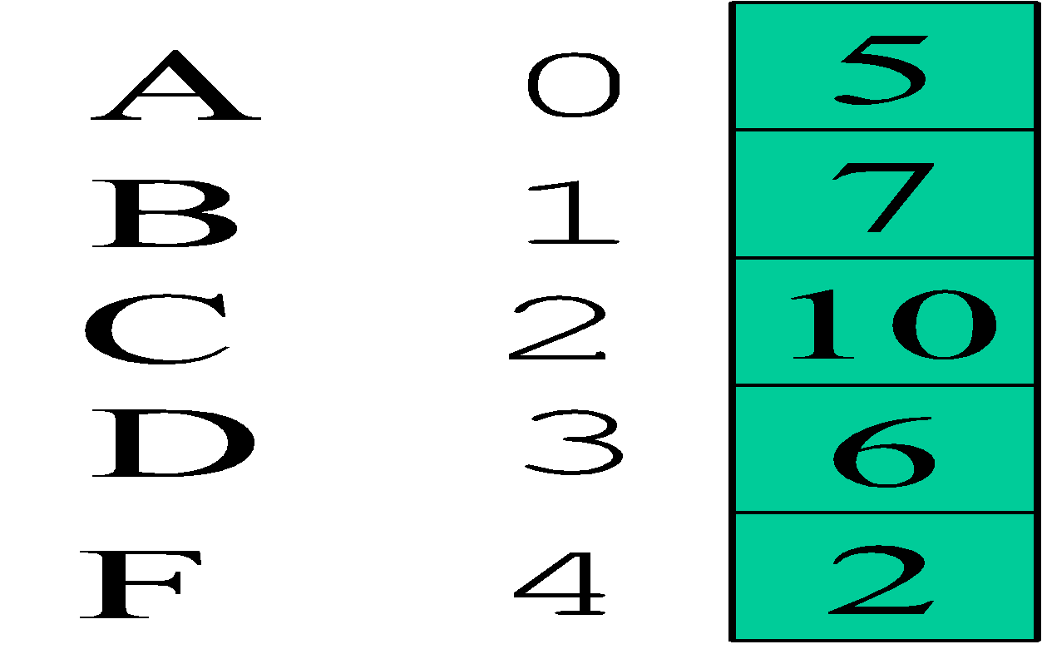
19.5 Graphing Data
This method takes into account the fact that positive y coordinates extend downward rather than upward on a computer screen.
Let us assume that the array grades contains the data in Table 19-5's second column - the Number of Students column.
The letter grades A, B, C, D, and F correspond to the index positions 0 through 4 of the array.

Slide 45
19.5 Graphing Data
The following code segment plots these data in a dotted line graph:
int i, x, y, largestNumber, xIncrement, yIncrement;
// Compute the x and y increments.
largestNumber = findLargest(grades);
xIncrement = totalXPixels / grades.length;
if (largestNumber == 0)
yIncrement = 0;
else
yIncrement = totalYPixels / largestNumber;
// Compute and plot the data points.
for (i = 0; i < grades.length; i++){
x = getXCoordinate (i + 1, xIncrement);
y = getYCoordinate (grades[i], yIncrement);
g.fillOval (x, y, 5, 5);
}

Slide 46
19.5 Graphing Data
Note that we add 1 to the value of i before passing it to getXCoordinate because that method expects numbers from 1 to the size of the array.
To connect the dots, we draw line segments between them.
We can also add a line segment between the graph's origin and the first dot.
Because a line segment has two endpoints, the code requires an extra pair of int variables:

Slide 47
19.5 Graphing Data
int i, x1, y1, x2, y2, largestNumber, xIncrement, yIncrement;
// Compute the x and y increments.
largestNumber = findLargest(grades);
xIncrement = totalXPixels / grades.length;
if (largestNumber == 0)
yIncrement = 0;
else
yIncrement = totalYPixels / largestNumber;

Slide 48
19.5 Graphing Data
// Set the initial end point.
x1 = X_LEFT;
y1 = Y_BOTTOM;
// Compute and plot the data points.
for (i = 0; i < grades.length; i++){
x2 = getXCoordinate (i + 1, xIncrement);
y2 = getYCoordinate (grades[i], yIncrement);
g.fillOval (x2, y2, 5, 5); //The dot size can be varied
if (x1 != X_LEFT)
g.drawLine (x1, y1, x2, y2);
x1 = x2;
y1 = y2;
}

Slide 49
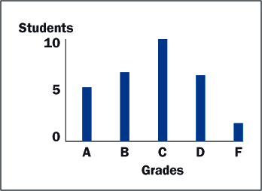
19.5 Graphing Data
Bar Graphs
A vertical bar graph shows the values as rectangular bars extending up from the x axis.
A horizontal bar graph shows the bars as extending to the right from the y axis.

Slide 50
19.5 Graphing Data
The following code segment displays a bar graph of the student grades:
int i, x, y, height, largestNumber, xIncrement, yIncrement;
// Compute the x and y increments.
largestNumber = findLargest (grades);
xIncrement = totalXPixels / grades.length;
if (largestNumber == 0)
yIncrement = 0;
else
yIncrement = totalYPixels / largestNumber;
// Draw the bars.
for (i = 0; i < grades.length; i++){
x = getXCoordinate (i + 1, xIncrement);
y = getYCoordinate (grades[i], yIncrement);
x = x – BAR_WIDTH / 2;
height = BOTTOM_Y – y + 1;
g.fillRect (x, y, BAR_WIDTH, height);
}

Slide 51
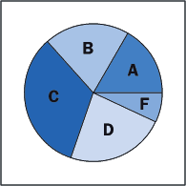
19.5 Graphing Data
Pie Charts
A pie chart shows the relative sizes of the data as wedges of a pie (Figure 19-9).
The size of a sector's central angle in a pie chart corresponds to a bar's height in a bar graph.
The angles for the data in our example are listed in Table 19-5.

Slide 52
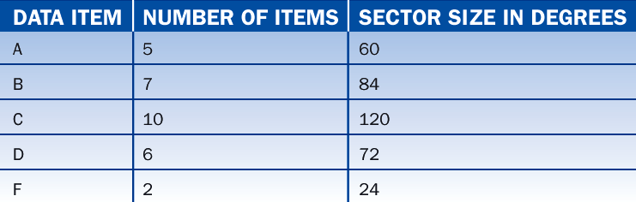
19.5 Graphing Data

Slide 53
19.5 Graphing Data
A complete code segment to draw the pie chart follows:
int totalUnits, centerX, centerY, radius, startAngle, i;
double unitAngleSize;
// Set up center point and radius of the pie, and the unit angle size.
totalUnits = sum(grades);
centerX = getWidth() / 2;
centerY = getHeight() / 2;
radius = centerX – centerX / 3;
centerX = radius;
centerY = centerY – centerY / 3;
if (totalUnits == 0)
unitAngleSize = 0;

Slide 54
19.5 Graphing Data
else
unitAngleSize = 360.0 / totalUnits;
startAngle = 0;
// Draw the wedges in the pie.
for (i = 0; i < grades.length; i++){
int centralAngle = (int) Math.round(unitAngleSize * grades[i]);
g.setColor (intToColor(i));
g.fillArc (centerX, centerY, radius, radius, startAngle, centralAngle);
startAngle = startAngle + centralAngle;
}

Slide 55
19.6 Responding to Mouse Events
Drawing applications usually detect and respond to the following mouse events:
button clicks
mouse movement
dragging the mouse (i.e., moving the mouse while a button is depressed)
A program can respond to the mouse's entry into and exit from a given region.
The GBPanel class includes methods for handling these events as described in Table 19-6.

Slide 56
19.6 Responding to Mouse Events
Each method has two parameters:
the x coordinate of the mouse when the event occurs
the y coordinate of the mouse when the event occurs

Slide 57
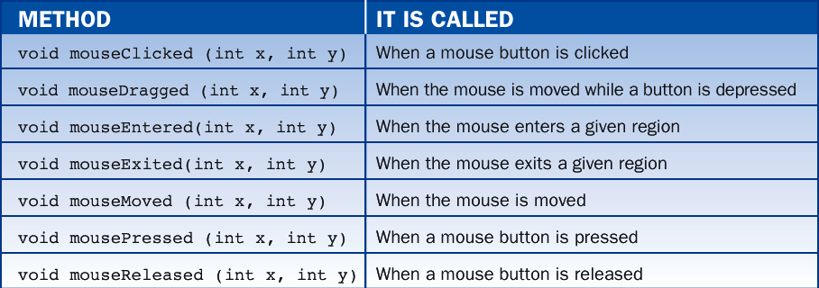
19.6 Responding to Mouse Events

Slide 58
19.6 Responding to Mouse Events
For example, the following panel class tracks the position of a mouse press by displaying the mouse's coordinates:
import BreezySwing.*;
import java.awt.*;
public class MousePanel extends GBPanel{
private int mouseX = 10, mouseY = 10;
public void paintComponent (Graphics g){
super.paintComponent(g);
g.drawString("(" + mouseX + "," + mouseY + ")", mouseX, mouseY);
}
public void mousePressed(int x, int y){
mouseX = x;
mouseY = y;
repaint();
}
}

Slide 59
19.7 Transient and Refreshable Images
To draw a permanent or refreshable image - one that reappears when the window is resized - the application must maintain a record of the image and redraw it when necessary.
Following is the modified program, called Sketchpad4:

Slide 60
19.7 Transient and Refreshable Images
import BreezySwing.*;
import java.awt.*;
public class Sketchpad4 extends GBPanel{
private static int MAX_POINTS = 500;
private int numPoints;
private int[] xArray;
private int[] yArray;

Slide 61
19.7 Transient and Refreshable Images
public Sketchpad4(){
setBackground(Color.white);
numPoints = 0;
xArray = new int[MAX_POINTS];
yArray = new int[MAX_POINTS];
}
public void paintComponent (Graphics g){
super.paintComponent(g);
displayPoints (g);
}
public void mouseDragged (int x, int y){
if (numPoints < xArray.length){
Graphics g = getGraphics();
g.fillOval (x, y, 2, 2);
savePoint (x, y);
}else
new GBFrame().messageBox ("Sorry: cannot draw another pellet.");
}

Slide 62
19.7 Transient and Refreshable Images
private void displayPoints (Graphics g){
int i;
for (i = 0; i < numPoints; i++){
g.fillOval (xArray[i], yArray[i], 2, 2);
}
}
private void savePoint (int x, int y){
xArray[numPoints] = x;
yArray[numPoints] = y;
numPoints++;
}
}

Slide 63
19.8 Defining and Using a Geometric Class
A circle object has a center, a radius, and a color.
Instances of class Circle recognize messages to access and modify these attributes and to draw themselves in a given graphics context.
Table 19-7 lists the methods.

Slide 64
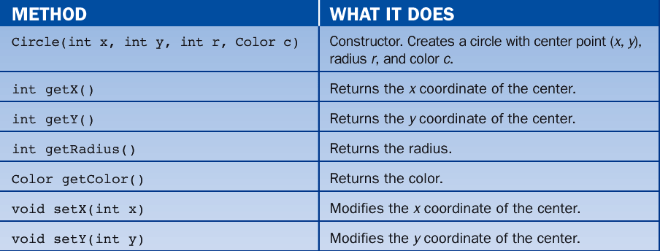
19.8 Defining and Using a Geometric Class

Slide 65
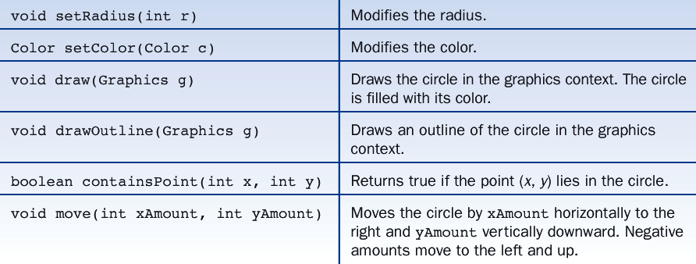
19.8 Defining and Using a Geometric Class

Slide 66
19.8 Defining and Using a Geometric Class
Following is an example of a paintComponent method that creates and draws a circle with center point (100, 100), radius 50, and color red:
public void paintComponent (Graphics g){
super.paintComponent(g);
Circle circle = new Circle (100, 100, 50, Color.red);
circle.draw (g);
}

Slide 67
19.8 Defining and Using a Geometric Class
Implementation of the Circle Class
public void draw (Graphics g){
// Save the current color of the graphics context
// and set color to the circle’s color.
Color oldColor = g.getColor();
g.setColor(color);
// Translate the circle's position and radius
// to the bounding rectangle's top left corner, width, and height.
g.fillOval(centerX - radius, centerY - radius, radius * 2, radius * 2);
// Restore the color of the graphics context.
g.setColor(oldColor);
}

Slide 68
19.8 Defining and Using a Geometric Class
To determine if a point is in a circle, we consider the familiar equation for all points on the circumference of a circle:
(x – xc)² + (y – yc)² = r² (Eq. 1)
or
(x – xc)² + (y – yc)² – r² = 0 (Eq. 2)
where (xc, yc) is the circle's center and r is its radius
A point (x, y) is then in the circle if the left side of Equation 2 is less than or equal to 0.
For example, given a circle of radius 2 and center (0, 0), the point (1, 1) produces the result
1² + 1² – 2² = -2
implying that point is in the circle

Slide 69
19.8 Defining and Using a Geometric Class
Following is the method that results from this design:
public boolean containsPoint (int x, int y){
int xSquared = (x - centerX) * (x - centerX);
int ySquared = (y - centerY) * (y - centerY);
int radiusSquared = radius * radius;
return xSquared + ySquared - radiusSquared <= 0;
}

Slide 70
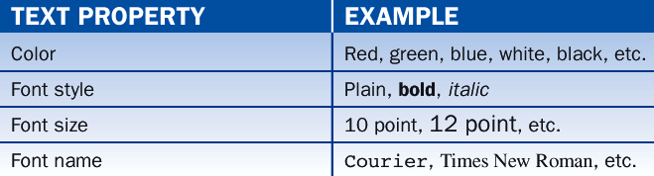
19.9 Text Properties
A text image has several properties, as shown in Table 19-8.
These are set by adjusting the color and font properties of the graphics context in which the text is drawn.

Slide 71
19.9 Text Properties
The Font Class
An object of class Font has three basic properties:
a name
a style
and a size
The following code creates one Font object with the properties Courier bold 12 and another with the properties Arial bold italic 10:
Font courierBold12 = new Font("Courier", Font.BOLD, 12);
Font arialBoldItalic10 = new Font("Arial", Font.BOLD + Font.ITALIC, 10);

Slide 72
19.9 Text Properties
The Font constants PLAIN, BOLD, and ITALIC define the font styles.
The font size is an integer representing the number of points, where one point equals 1/72 of an inch.
The available font names depend on your particular computer platform.
To see what they are, run the code segment:
String fontNames[] = Toolkit.getDefaultToolkit().getFontList();
int i;
for (i = 0; i < fontNames.length; i++)
System.out.println (fontNames[i]);

Slide 73
19.9 Text Properties
The code:
Declares the variable fontNames as an array of strings.
Runs the Toolkit class method getDefaultToolkit, which returns the default toolkit for the particular computer platform.
Runs the method getFontList on the toolkit. This method returns a list of the available font names.
Sets the array fontNames to this list.
Executes a loop that displays the contents of fontNames in the terminal window.

Slide 74
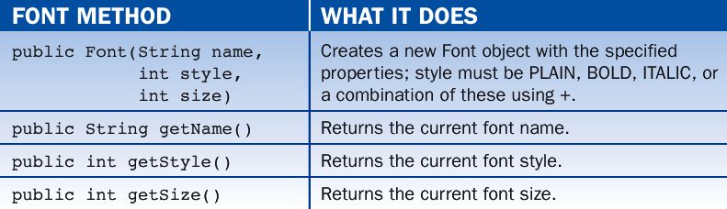
19.9 Text Properties
Table 19-9 lists the principal font methods:

Slide 75
19.9 Text Properties
Setting the Color and Font Properties of Text
Assume that we want to display the text "Hello world!" in green with the font Courier bold 14. The following code would do this:
Changing the font and color of a graphics context affects all subsequent graphics operations in that context but does not alter the font or color of existing images.
Font ourFont = new Font ("Courier", Font.BOLD, 14);
Color ourColor = Color.GREEN;
Graphics g = getGraphics();
g.setColor (ourColor);
g.setFont (ourFont);
g.drawString ("Hello world!", 100, 100);

Slide 76
Lesson 20: Files

Slide 77
Lesson 20: Files
Objectives:
Understand the use of the classes in the java.io package for processing files.
Open and use input file streams for reading from text files one character, one line, or one word at a time.
Understand how to catch exceptions that can occur when opening files and reading from them.
Use data input and output streams for the transfer of specific types of data to and from files.

Slide 78
Lesson 20: Files
Objectives:
Work with object input streams and output streams to serialize objects.
Understand the classes used to perform terminal input and output.
Use file dialogs to open connections to input and output files.

Slide 79
Lesson 20: Files
Vocabulary:
buffer
data flow diagram
exception-driven loop
flushing
input stream
output stream
sequential access
serialization
text files
token

Slide 80
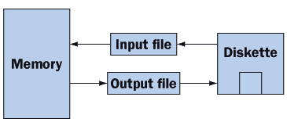
20.1 File Classes
When working with files, a program deals with Java classes which manage the actual transfer of data between memory and secondary storage.
In Figure 20-1, the boxes labeled "Input file" and "Output file" represent instances of these Java classes.

Slide 81
20.1 File Classes
Java supports two types of file access:
Sequential
Random
If we imagine a file as a long sequence of contiguous bytes, then random access allows a program to retrieve a byte or group of bytes from anywhere in a file.
Sequential access forces a program to retrieve bytes sequentially starting from the beginning of a file.

Slide 82
20.1 File Classes
Java views the data in files as a stream of bytes.
A stream of bytes from which data are read is called an input stream.
A stream of bytes to which data are written is called an output stream.
Java provides classes for connecting to and manipulating data in a stream.
The classes are defined in the package java.io and are organized in a large complex hierarchy, a small portion of which is shown in Figures 20-2 and 20-3.

Slide 83
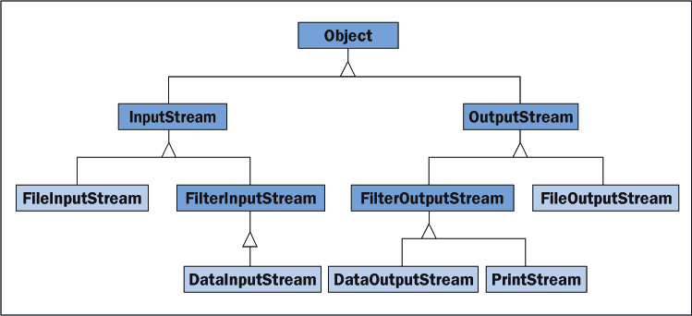
20.1 File Classes

Slide 84
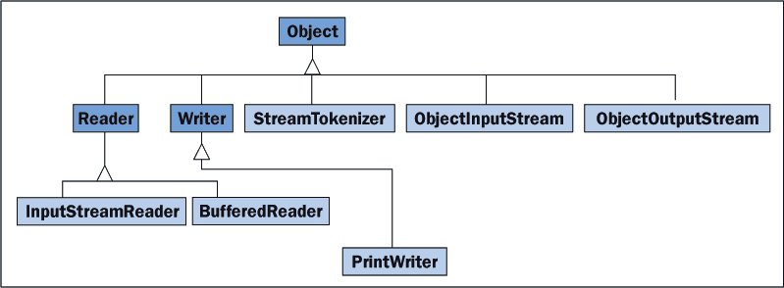
20.1 File Classes

Slide 85
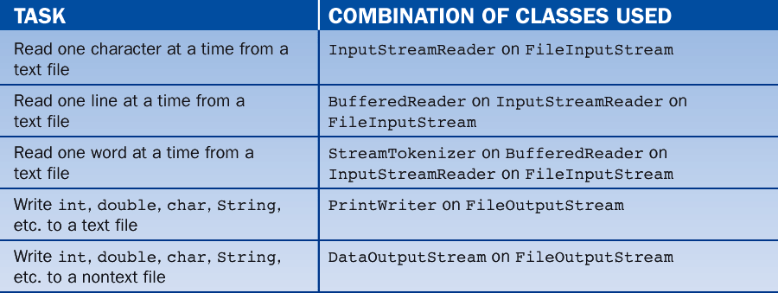
20.1 File Classes
Table 20-1 shows the combinations of classes used in several common I/O situations:

Slide 86
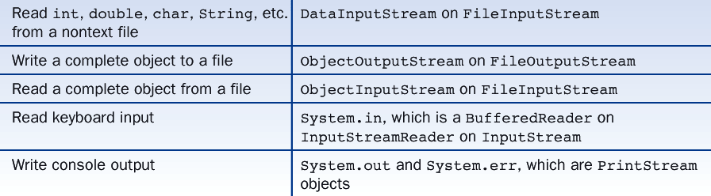
20.1 File Classes

Slide 87
20.1 File Classes
Here are short summaries of some of the classes taken verbatim from Sun's Java documentation.
InputStream:
this abstract class is the superclass of all classes representing an input stream of bytes.
FileInputStream:
obtains input bytes from a file in a file system.
Reader:
abstract class for reading character streams.

Slide 88
20.1 File Classes
InputStreamReader:
a bridge from byte streams to character streams: It reads bytes and translates them into characters according to a specified character encoding. The encoding that it uses may be specified by name, or the platform's default encoding may be accepted.
BufferedReader:
read text from a character-input stream, buffering characters so as to provide for the efficient reading of characters, arrays, and lines.
StreamTokenizer:
takes an input stream and parses it into "tokens", allowing the tokens to be read one at a time.

Slide 89
20.1 File Classes
OutputStream:
this abstract class is the superclass of all classes representing an output stream of bytes. An output stream accepts output bytes and sends them to some device.
FileOutputStream:
an output stream for writing data to a File.
Writer:
abstract class for writing to character streams.
PrintWriter:
prints formatted representations of objects to a text-output stream.

Slide 90
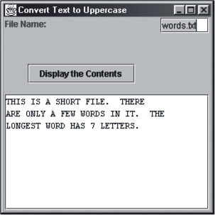
20.2 File Input
Figure 20-4 displays a program that reads a text file, converts all alphabetical characters to uppercase, and displays the result in a text area.
To use the program, type a file name in the text field and select the Display the Contents button.
A stub replaces the method for reading and processing the file.

Slide 91
20.2 File Input
A typical file input process is described in the following pseudocode algorithm:
Open an input connection to a file
Read the data from the file and process them
Close the input connection to the file

Slide 92
20.2 File Input
Following is the program with a stub taking the place of the method readAndProcessData:
import javax.swing.*;
import java.io.*;
import BreezySwing.*;
public class ConvertText extends GBFrame{
//Window objects
private JLabel nameLabel;
private JTextField nameField;
private JButton displayButton;
private JTextArea output;
//Constructor
public ConvertText(){
nameLabel = addLabel ("File Name:" ,1,1,1,1);
nameField = addTextField ("" ,1,2,1,1);
displayButton = addButton ("Display the Contents",2,1,2,1);
output = addTextArea ("" ,3,1,2,6);
nameField.requestFocus(); //Move cursor to nameField
output.setEditable(false); //Prevent user from modifying output
setTitle("Convert Text to Uppercase"); //Give the window a title
}

Slide 93
20.2 File Input
//Respond to the command button
public void buttonClicked(JButton buttonObj){
//Get the name of the text file
String fileName = nameField.getText();
try{
//Open an input connection on the file, read and process the file,
//close the file.
FileInputStream stream = new FileInputStream(fileName);
readAndProcessData(stream);
stream.close();
}catch(IOException e){
//If cannot open the file, then inform the user.
messageBox("Error in opening input file:\n" + e.toString());
}

Slide 94
20.2 File Input
//Get ready for the user's next input
nameField.requestFocus(); //Move cursor to nameField
nameField.selectAll(); //and select all text in the field
}
//Read and process the data (this is a stub)
private void readAndProcessData(FileInputStream stream){
messageBox("Running readAndProcessData\n" +
"File opened successfully");
}
public static void main (String[] args){
ConvertText tpo = new ConvertText();
tpo.setSize(300, 300);
tpo.setVisible(true);
}
}

Slide 95
20.2 File Input
Exception Handling
Java responds to run-time errors by throwing exceptions.
The try-catch statement provides a mechanism for handling exceptions under program control without forcing the program to stop.

Slide 96
20.2 File Input
Opening and Closing a FileInputStream
The buttonClicked method in our previous example program:
opens a file input stream on the user's file name
passes the stream to a method for reading and processing the data
closes the stream

Slide 97
20.2 File Input
Code embedded in a try-catch statement consists of two parts:
A try clause:
A block of code is included here. If a run-time error occurs in this block, Java throws an exception and control passes immediately to a catch clause.
One or more catch clauses:
Each catch clause is qualified by a particular kind of exception that might be thrown in the try statement.
The code for opening and closing a file stream is always embedded in a try-catch statement; otherwise, there is a compile-time error.

Slide 98
20.2 File Input
Reading Data from a Text File
After a file input stream has been successfully opened, we can read data from it.
A text file is one that contains nothing but characters.
Java provides several ways to read characters from a file:
one character at a time, using the class InputStreamReader
one line at a time, using the class BufferedReader
one word at a time, using the class StreamTokenizer
To utilize the desired type of input, the Java programmer uses the appropriate class and methods.

Slide 99
20.2 File Input
Reading Data One Character at a Time
The following code segment shows how the method readAndProcessData is coded to read text from a file one character at a time:

Slide 100
20.2 File Input
private void readAndProcessData (FileInputStream stream){
InputStreamReader reader = new InputStreamReader (stream);
int asciiValue;
char ch;
try{
output.setText("");
asciiValue = reader.read(); //read returns an int
while (asciiValue != -1){ //-1 indicates end of stream
ch = Character.toUpperCase ((char)asciiValue); //cast and convert
output.append (String.valueOf(ch)); //convert a char to a String
asciiValue = reader.read();
}
}catch(IOException e){
messageBox ("Error in file input:\n" + e.toString());
}
}

Slide 101
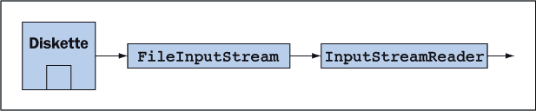
20.2 File Input
First the method instantiates an InputStreamReader on a FileInputStream object.
The result is shown in Figure 20-5.

Slide 102
20.2 File Input
The method uses a try-catch statement to read data from the stream. The form of the input loop is fairly general.
get the first datum from the stream
while (the datum does not indicate that the end of stream has been reached)
process the datum
get the next datum from the stream
}

Slide 103
20.2 File Input
Note three other points:
The read method returns -1 on reaching the end of the stream.
The read method returns a value of type int, which corresponds to the ASCII value of the character in the file. This value is cast to char before further processing.
The catch clause handles any IOException that might occur as the stream is read.

Slide 104
20.2 File Input
Reading Data One Line at a Time
The next version of the readAndProcessData method reads text from a file one line at a time:
private void readAndProcessData (FileInputStream stream){
InputStreamReader iStrReader = new InputStreamReader (stream);
BufferedReader reader = new BufferedReader (iStrReader);
String line;
try{
output.setText("");
line = reader.readLine();
while (line != null){ //null indicates end of stream
line = line.toUpperCase();
output.append (line + "\n");
line = reader.readLine();
}
}catch(IOException e){
messageBox ("Error in file input:\n" + e.toString());
}
}

Slide 105
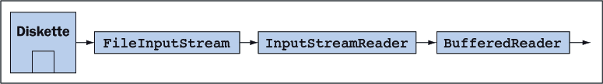
20.2 File Input
To set up the reader, we proceed as before by first connecting an input stream reader to the file input stream.
To the input stream reader we then connect an instance of BufferedReader.
The result is shown in Figure 20-6.
When the programmer uses a BufferedReader for input, Java uses an area of memory called a buffer to read large chunks of text from the file rather than single characters.

Slide 106
20.2 File Input
Reading Data One Word at a Time
Sequences of characters separated by whitespace characters (blanks, tabs, newlines) can be processed as words or tokens.
Suppose a file contains the sequence "16 cats sat on 4 mats."
It contains the separate tokens:
16
cats
sat
on
4
mats
Java provides a StreamTokenizer class for reading tokens from a file.

Slide 107
20.2 File Input
The following code segment revisits our example program to show how tokens are read from a file stream:
private void readAndProcessData (FileInputStream stream){
InputStreamReader iStrReader = new InputStreamReader (stream);
BufferedReader bufReader = new BufferedReader (iStrReader);
StreamTokenizer reader = new StreamTokenizer (bufReader);
//Add periods, commas, semicolons, and exclamation marks to the
//standard set of whitespace characters.
reader.whitespaceChars ('.', '.');
reader.whitespaceChars (',', ',');
reader.whitespaceChars ('!', '!');
reader.whitespaceChars (';', ';');

Slide 108
20.2 File Input
String token = "";
try{
output.setText("");
reader.nextToken();
while (reader.ttype != StreamTokenizer.TT_EOF){
if (reader.ttype == StreamTokenizer.TT_WORD){
token = reader.sval;
token = token.toUpperCase();
}else if (reader.ttype == StreamTokenizer.TT_NUMBER)
token = reader.nval + "";
output.append (token + "\n");
reader.nextToken();
}
} catch (IOException e){
messageBox ("Error in file input:\n" + e.toString());
}
}

Slide 109
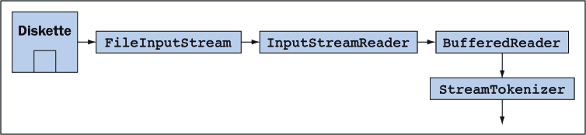
20.2 File Input
The setup of the stream extends our previous setup by connecting an instance of StreamTokenizer to a buffered reader.
The combination is illustrated in Figure 20-7:

Slide 110
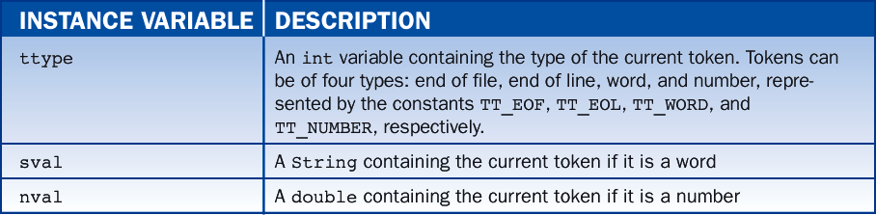
20.2 File Input
The code uses three instance variables in the class StreamTokenizer.
These are described in Table 20-2:

Slide 111
20.2 File Input
The method nextToken() reads the next token from the input stream and updates the tokenizer's instance variables with information about the type and value of the token.
The nextToken method skips whitespace between words and numbers.
Notice that it is possible to treat additional characters as whitespace.

Slide 112
20.3 File Output
We now turn our attention to file output.
The file output process conforms to the following pattern:
Open an output connection to a file
Write data to the file
Close the output connection to the file

Slide 113
20.3 File Output
Opening and Closing a FileOutputStream
The code segment shown below:
opens a file output stream on a file named test.txt
passes the stream to a method for writing the data
closes the stream
try{
FileOutputStream stream = new FileOutputStream ("test.txt");
writeData (stream);
stream.close();
}catch(IOException e){
messageBox ("Error opening output file " + e.toString());
}

Slide 114
20.3 File Output
Writing Data to a PrintWriter
The class PrintWriter writes data to a file output stream as encoded characters.
The resulting file can be read with a text editor or an input stream reader.
The PrintWriter methods print and println each take a single parameter, which can be any data type.

Slide 115
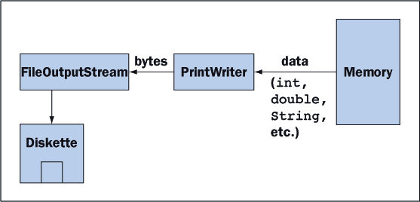
20.3 File Output
Figure 20-11 shows the flow of data from memory to a print writer to a file output stream to disk.

Slide 116
20.3 File Output
the writeData method performs the following actions:
opens a print writer on the file output stream
writes a header message followed by a newline to the print writer
writes 10 random integers between 1 and 10, separated by spaces, to the print writer
void writeData(FileOutputStream fileOutputStream){
int i;
PrintWriter printWriter = new PrintWriter (fileOutputStream, true);
printWriter.println ("Here are 10 random integers: ");
for (i = 1; i <= 10; i++)
printWriter.print ((int) (1 + Math.random() * 10) + " ");
}

Slide 117
20.3 File Output
The preferred constructor for a print writer takes a Boolean parameter that indicates whether or not the application desires the output stream to be flushed.
Flushing sends any data left in the output buffer to the disk.
A print writer throws no exceptions, so a try-catch statement is not necessary.

Slide 118
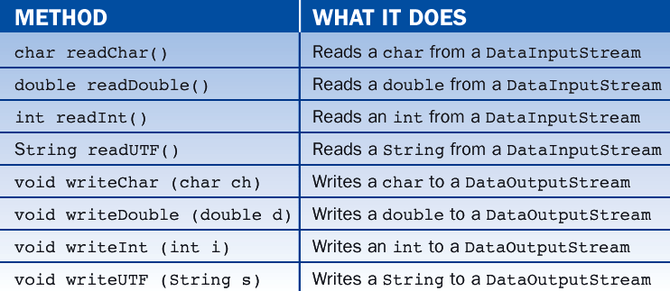
20.4 Other Input/Output Situations
Data Input and Output Streams
Table 20-3 lists several useful methods in the classes DataInputStream and DataOutputStream:

Slide 119
20.4 Other Input/Output Situations
A program reading from a data input stream must know the order and types of data expected at each moment.
/* TestDataStreams.java
1) Write randomly generated integers to a data output stream. A command line
parameter specifies the number of integers to generate.
2) Read them back in using a data input stream and display them in
the terminal window.
*/
import java.io.*;
public class TestDataStreams{
public static void main (String[] args){
//Obtain the number of ints from the command line parameters.
int number = Integer.valueOf(args[0]).intValue();
//Generate random ints and write them to a data output stream.
try{
FileOutputStream foStream = new FileOutputStream("ints.dat");
DataOutputStream doStream = new DataOutputStream(foStream);
int i;

Slide 120
20.4 Other Input/Output Situations
for (i = 0; i < number; i++)
doStream.writeInt((int) (Math.random() * number + 1));
doStream.close();
}catch(IOException e){
System.err.println("Error during output: " + e.toString());
}
//Read the ints from a data input stream and display them in
//a terminal window.
try{
FileInputStream fiStream = new FileInputStream("ints.dat");
DataInputStream diStream = new DataInputStream(fiStream);
while (true){
int i = diStream.readInt();
System.out.println(i);
}
}catch(EOFException e){
System.out.println("\nAll done.");
}catch(IOException e){
System.err.println("Error in input" + e.toString());
}
}
}

Slide 121
20.4 Other Input/Output Situations
A data input stream is processed within an exception-driven loop.
Using the expression while (true), the loop continues until an EOFException occurs.
This exception is not viewed as an error but rather as a good reason to exit the loop.
The catch statement in this example prints a reassuring message.

Slide 122
20.4 Other Input/Output Situations
Here are two rules of thumb for handling file input and output:
It is appropriate to use a print writer for output and a stream tokenizer for input when the file must be viewed or created with a text editor or when the order and types of data are unknown.
It is appropriate to use a data input stream for input and a data output stream for output when the file need not be viewed or created with a text editor and when the order and types of data are known.

Slide 123
20.4 Other Input/Output Situations
Serialization and Object Streams
Java provides methods for reading and writing complete objects.
This makes it easy to save a program's state before closing it and to restore the state when the program is run again.
Objects that are saved between executions of a program are said to be persistent.
The process of writing them to and reading them from a file is called serialization

Slide 124
20.4 Other Input/Output Situations
To use serialization, a programmer must do two things:
Make classes serializable.
Write objects using an ObjectOutputStream and read them later using an ObjectInputStream.

Slide 125
20.4 Other Input/Output Situations
To serialize the classes used in the student test scores program in Lesson 8, we import the package java.io and add the qualifier implements Serializable to each class's definition:
import java.io.*;
public class StudentTestScoresModel implements Serializable{
// Instance variables
private Student[] students = new Student[10];
private int indexSelectedStudent;
private int studentCount;
. . .
}

Slide 126
20.4 Other Input/Output Situations
import java.io.*;
public class Student implements Serializable{
// Instance variables
private String name;
private int[] tests = new int[NUM_TESTS];
. . .
}

Slide 127
20.4 Other Input/Output Situations
Saving and restoring the program's data involves nothing more than serializing this single object, which we do in the methods saveModel and loadModel.
These methods are activated when the user selects the menu options File/Save and File/Open, respectively. The additions to the view are in blue type:

Slide 128
20.4 Other Input/Output Situations
import java.io.*;
import javax.swing.*;
import BreezySwing.*;
public class StudentTestScoresView extends GBFrame{
. . .
private JMenuItem saveModelMI, loadModelMI;
. . .
private StudentTestScoresModel model;
. . .
public StudentTestScoresView(){
saveModelMI = addMenuItem ("File","Save");
loadModelMI = addMenuItem ("File","Open");
. . .
}

Slide 129
20.4 Other Input/Output Situations
public void menuItemSelected (JMenuItem menuItemObj){
. . .
else if (menuItemObj == saveModelMI)
saveModel();
else if (menuItemObj == loadModelMI)
loadModel();
. . .
}
. . .

Slide 130
20.4 Other Input/Output Situations
private void saveModel(){
String outputFileName;
. . . use a file dialog to ask the user for the name
of the output file as explained soon . . .
try{
FileOutputStream foStream = new FileOutputStream (outputFileName);
ObjectOutputStream ooStream = new ObjectOutputStream (foStream);
ooStream.writeObject (model);
foStream.flush();
foStream.close();
}catch (IOException e){
messageBox ("Error during output: " + e.toString());
}
}

Slide 131
20.4 Other Input/Output Situations
private void loadModel(){
String inputFileName;
. . . use a file dialog to ask the user for the name
of the input file as explained soon . . .
try{
FileInputStream fiStream = new FileInputStream (inputFileName);
ObjectInputStream oiStream = new ObjectInputStream (fiStream);
model = (StudentTestScoresModel) oiStream.readObject();
fiStream.close();
}catch (Exception e){
messageBox ("Error during input: " + e.toString());
}
}
. . .
}

Slide 132
20.4 Other Input/Output Situations
In this code, the method writeObject outputs the model object to the object output stream
This triggers automatic serialization of the array of students and each individual student in the array.
The method readObject inputs the model object and all its constituent parts from the object input stream.

Slide 133
20.4 Other Input/Output Situations
Terminal Input and Output
Using the terminal input stream is quite complicated and usually involves the following steps:
Open an InputStreamReader on the object System.in.
Open a BufferedReader on the resulting input stream reader.
Use the method readLine() to read a line of text (a String) from the buffered reader.
Convert this string to a primitive data type as appropriate.

Slide 134
20.4 Other Input/Output Situations
The following program uses the three terminal streams in a brief interaction with the user:
/* TestTerminal.java
A simple demonstration of terminal I/O.
*/
import java.io.*;
public class TestTerminal{
public static void main (String[] args){
String name;
int age;
double weight;
while (true){

Slide 135
20.4 Other Input/Output Situations
try{
//Instantiate a buffered reader on System.in
InputStreamReader reader = new InputStreamReader(System.in);
BufferedReader buffer = new BufferedReader(reader);
//Prompt the user for a name.
//Read the name and save it in a string variable.
System.out.print("\nEnter your name or \"quit\": ");
name = buffer.readLine();
//Break if name equals "quit"
if (name.equals ("quit")) break;

Slide 136
20.4 Other Input/Output Situations
//Prompt the user for an age.
//Read the age as a string, convert it to an integer, and
//store it in an int variable.
System.out.print("Enter your age: ");
age = (Integer.valueOf(buffer.readLine())).intValue();
//Prompt the user for a weight.
//Read the weight as a string, convert it to a double,
//and store it in a double variable.
System.out.print("Enter your weight: ");
weight = (Double.valueOf(buffer.readLine())).doubleValue();

Slide 137
20.4 Other Input/Output Situations
//Output the results
if (age <= 15)
System.err.println
("Sorry: use of this program is restricted to those over 15!");
else
System.out.println
(name + ", age " + age + ", weight " + weight);
}catch(Exception e){
//Flag input errors
System.err.println("Input error -- " + e.toString());
}
}
System.out.println("Done");
}
}

Slide 138
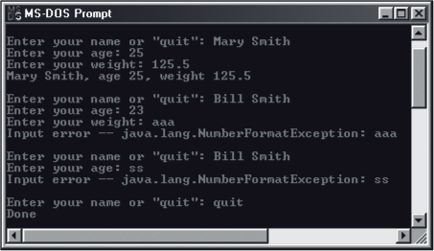
20.4 Other Input/Output Situations
A sample session with this program is shown in Figure 20-14:

Slide 139
20.4 Other Input/Output Situations
If a file dialog is used, the user can browse through the computer's directory structure to find a desired file name or can back out by canceling the dialog.
Figure 20-15 shows a typical file dialog as supported by Swing's JFileChooser class.
Table 20-4 lists important JFileChooser methods.

Slide 140
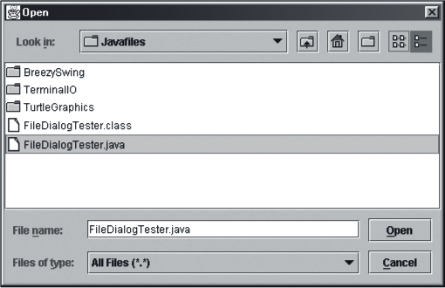
20.4 Other Input/Output Situations

Slide 141
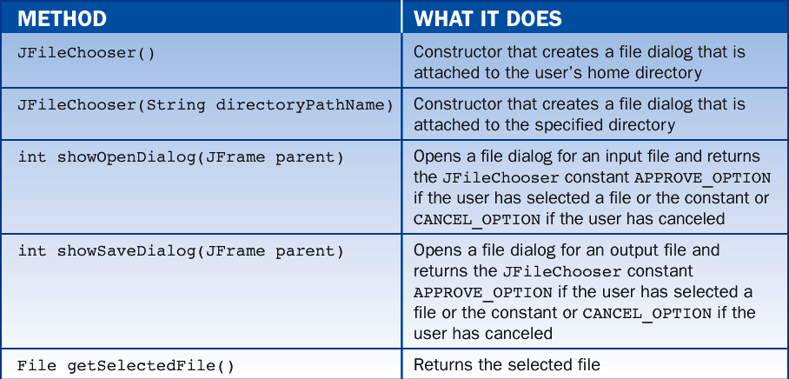
20.4 Other Input/Output Situations

Slide 142
20.4 Other Input/Output Situations
The following code segment displays a file dialog for an input file.
After the dialog closes, the code displays the file name if the user did not cancel the dialog; otherwise, the code displays a message saying the dialog was canceled.
JFileChooser chooser = new JFileChooser("c:\\Javafiles");
int result = chooser.showOpenDialog(this);
if (result = JFileChooser.CANCEL_OPTION)
messageBox ("The dialog was cancelled.");
else
try{
File file = chooser.getSelectedFile();
messageBox ("File name: " + file.getName());
}catch(Exception e){
messageBox("Error opening input file " + e.toString());
}

Slide 143
20.4 Other Input/Output Situations
The following is a segment that combines opening the file and processing its data:
JFileChooser chooser = new JFileChooser("c:\\Javafiles");
int result = chooser.showOpenDialog(this);
if (result == JFileChooser.APPROVE_OPTION)
try{
File file = chooser.getSelectedFile();
FileInputStream stream = new FileInputStream (file);
processData (stream);
stream.close();
}catch (IOException e){
messageBox ("Error opening input file " + e.toString());
}

Slide 144
Lesson 21: Introduction to HTML and Applets

Slide 145
Lesson 21: Introduction to HMTL and Applets
Objectives:
Understand the basic features of hypertext, hypermedia, and the World-Wide Web.
Use basic HTML markup tags to format text for a Web page.
Construct an HTML list and an HTML table to represent a linear sequence of items and a two-dimensional grid of items, respectively.
Use the appropriate markup tags to include images in Web pages.

Slide 146
Lesson 21: Introduction to HMTL and Applets
Objectives:
Create links to other Web pages using absolute or relative pathnames.
Convert a Java application to an applet and embed the applet in a Web page.
Understand the constraints on applets that distinguish them from Java applications.

Slide 147
Lesson 21: Introduction to HMTL and Applets
Vocabulary:
absolute path name
associative link
definition list
external image
hyperlinks
hypermedia
hypertext
hypertext markup language (HTML)
inline image
markup tag
memex
relative path name
uniform resource locator (URL)

Slide 148
21.1 Hypertext, Hypermedia, and the World Wide Web
Hypertext and Hypermedia
In 1967 Theodor Holm Nelson coined the term hypertext.
A hypertext is a structure consisting of nodes and the links between them.
Each node is a document or chunk of text.
Typically, links to other nodes are displayed as embedded, highlighted terms within a given chunk of text.
The user moves to a node by using an arrow key or mouse to select an associated term.

Slide 149
21.1 Hypertext, Hypermedia, and the World Wide Web
Networks and the World Wide Web
The Web consists of two kinds of machines:
Servers
Pages of information reside on servers
Clients
Run browsers (software programs) to access information on the servers

Slide 150
21.1 Hypertext, Hypermedia, and the World Wide Web
When you open a browser, you are presented with an initial page of information.
Embedded in this page are links to other nodes.
When you select a link, the following occurs:
The browser sends a message to the node's machine, requesting a transfer of its information.
If the request is successful, the information at the node is downloaded to the user's browser.

Slide 151
21.1 Hypertext, Hypermedia, and the World Wide Web
Because there are different types of computers, a networked hypermedia system requires a uniform means of:
representing information using a machine-independent hypertext markup language
assigning node addresses using machine-independent uniform resource locators (URLs)
transmitting information from site to site using machine-independent network transmission protocols
displaying information with browsers from different vendors, subject to the restriction that all the browsers behave in a similar manner

Slide 152
21.2 Overview of the Hypertext Markup Language
The hypertext markup language (HTML) was developed as a machine-independent way of representing information in a networked-based hypermedia system.
Codes, called markup tags, can indicate the format of textual elements or links to other nodes.
Browsers interpret these codes as commands and display the text in the desired format.
Figure 21-1 shows the relationship between authors and users of HTML documents.

Slide 153
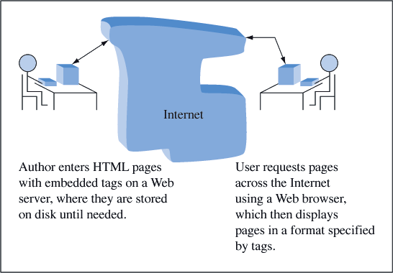
21.2 Overview of the Hypertext Markup Language

Slide 154
21.2 Overview of the Hypertext Markup Language
A Short Example
As a first example of using HTML, we will show you how to create the Web page shown in Figure 21-2.
The page includes markup tags for:
a title
a heading
two paragraphs of text

Slide 155
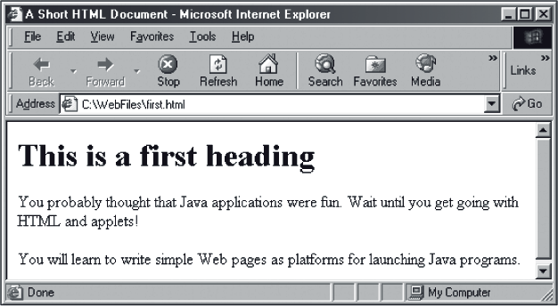
21.2 Overview of the Hypertext Markup Language

Slide 156
21.2 Overview of the Hypertext Markup Language
The author of the page had to write an HTML document that looks like this:
<html>
<head>
<TITLE>A Short HTML Document</TITLE>
</head>
<body>
<H1>This is a first heading</H1>
<P>You probably thought that Java applications were fun. Wait until
you get going with HTML and applets!</P>
<P>You will learn to write simple Web pages as platforms
for launching Java programs.</P>
</body>
</html>

Slide 157
21.2 Overview of the Hypertext Markup Language
Markup Tags
In HTML, a markup tag begins with a left angle bracket (<) and ends with a right angle bracket (>)
for example: <title>
Tags are not case sensitive.
the tags <title>, <TITLE>, and< TiTlE> are equivalent
Tags usually occur in pairs
for example: <title> and </title>
The start tag tells the browser where to begin the format, and the end tag, which includes a slash (/), tells the browser where to end the format.

Slide 158
21.2 Overview of the Hypertext Markup Language
Tags can include attributes.
For example, the tag <P ALIGN=CENTER> tells the browser to align the next paragraph in the center of the window.
ALIGN is the attribute’s name
CENTER is the attribute’s value
Some commonly used markup tags are listed in Table 21-1.

Slide 159
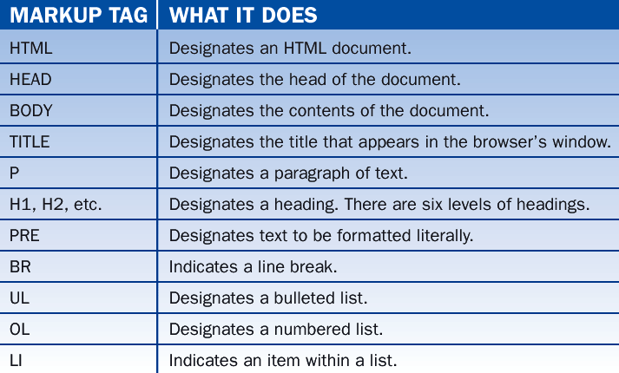
21.2 Overview of the Hypertext Markup Language
Basic HTML markup tags:

Slide 160
21.2 Overview of the Hypertext Markup Language
Minimal Document Structure
Every HTML document should have the following minimal structure:
<html>
<head>
<TITLE> the title goes here </TITLE>
</head>
<body>
the text for the document goes here
</body>
</html>

Slide 161
21.2 Overview of the Hypertext Markup Language
Note the following points:
The HTML tag informs the browser that it is dealing with an HTML document.
The HEAD tag identifies the first part of the document.
The TITLE tag identifies the document's title.
The title is displayed at the top of the browser's window and is used during searches for the document. The title is also displayed in bookmark lists (a list of the user's favorite links).
The BODY tags enclose the information provided by the HTML document.
The browser ignores extra white space, such as blank lines and tab characters.

Slide 162
21.2 Overview of the Hypertext Markup Language
Commenting an HTML Document
Authors often add comments to an HTML document.
The browser does not interpret comments or show them to the reader.
The form of a comment is:
<!-- text of comment -->

Slide 163
21.3 Simple Text Elements
Headings
HTML provides six levels of document headings, numbered H1 through H6.
Headings are displayed in a different font size and style from normal text.
The browser inserts a blank line after each heading.
The form of a heading is:
<Hnumber>Text of heading</Hnumber>

Slide 164
21.3 Simple Text Elements
Paragraphs
The end tag </P> may be omitted.
The browser then ends the paragraph at the beginning of the next paragraph or heading tag.
The browser recognizes the following alignment attributes:
LEFT (the default)
RIGHT
CENTER

Slide 165
21.3 Simple Text Elements
The next example uses headings of several sizes and paragraphs with different alignments:
<H1>The first level heading</H1>
<P ALIGN=RIGHT>The first paragraph.</P>
<H2>The second level heading</H2>
<P ALIGN=CENTER>The second paragraph.</P>
<H3>The third level heading</H3>
<P>The third paragraph.</P>

Slide 166
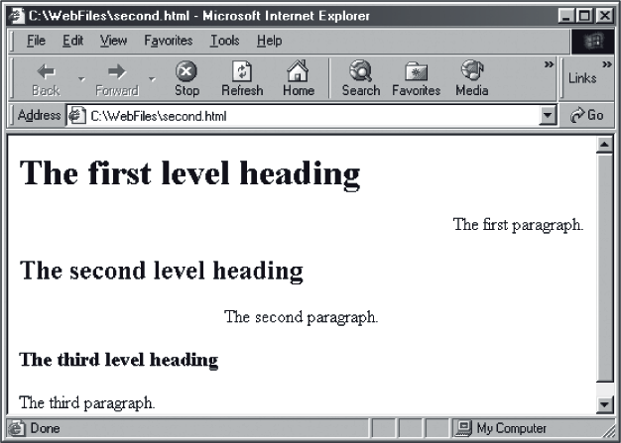
21.3 Simple Text Elements
The results of this example are shown in Figure 21-3.

Slide 167
21.3 Simple Text Elements
Forced Line Breaks
The line break tag, <BR>, is used to display several lines of text without word wrap.
Because a line break tag tells the browser where to break a line, no other end tag is required.
For example, the following HTML segment would display the author’s address:
Department of Computer Science<BR>
Washington and Lee University<BR>
Lexington, VA 24450<BR>

Slide 168
21.3 Simple Text Elements
Preformatted Text
The <PRE> tag displays text “as is,” with line breaks, extra spaces, and tabs.
In general, you should not use other markup tags within a chunk of preformatted text.
<PRE>
public static void main (String[] args){
Frame frm = new FahrenheitToCentigrade();
frm.setSize (200, 150);
frm.setVisible (true);
}
</PRE>

Slide 169
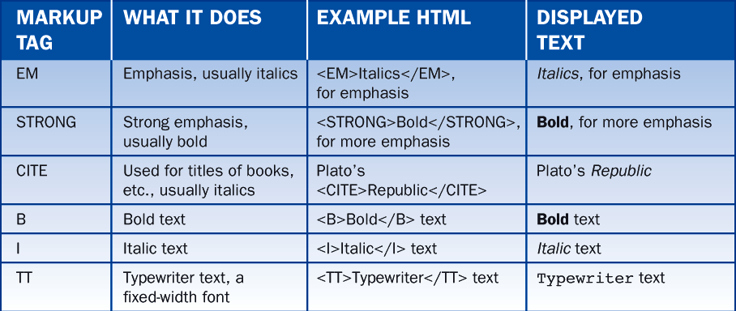
21.4 Character-Level Formatting
HTML provides some control over the format of characters.
Table 21-2 lists some of the commonly used tags and their effects:

Slide 170
21.4 Character-Level Formatting
Escape Sequences
HTML treats <, >, and & as special characters.
If you want the browser to display these characters rather than interpret them, you must use the escape sequences listed in Table 21-3.

Slide 171
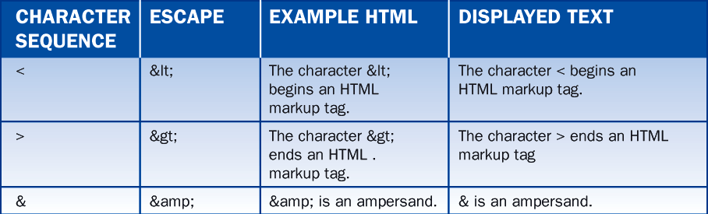
21.4 Character-Level Formatting

Slide 172
21.5 Lists
There are three kinds of lists that can be displayed in a Web page:
unordered (bulleted) lists
Use UL tag
numbered (ordered) lists
use OL tag
definition (association) lists
use DL tag

Slide 173
21.5 Lists
For bulleted and numbered lists, you perform the following steps:
Start with the desired list tag (UL or OL).
For each item, enter the LI (list item) tag followed by the text of the item.
No closing tags are needed for the items.
End with the desired list tag.

Slide 174
21.5 Lists
An Unordered List Example:
<UL>
<LI>Fundamentals of Data Structures
<LI>Programming Language Design
<LI>Operating Systems
<LI>Artificial Intelligence
</UL>

Slide 175
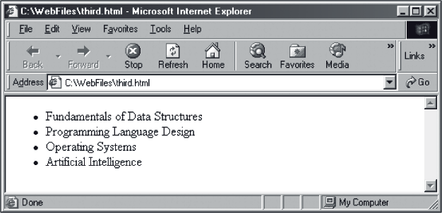
21.5 Lists
Figure 21-4 shows the page resulting from this HTML segment.

Slide 176
21.5 Lists
A Definition List Example:
A definition list displays terms and their associated definitions.
Several tags are used with these lists:
The tag <DL> begins the definition list and ends it.
The tag <DT> precedes each term in a definition list.
The tag <DD> precedes each definition in a definition list.

Slide 177
21.5 Lists
The following example uses a definition list to add course numbers to the course list:
<DL>
<DT>CSCI111
<DD>Fundamentals of Data Structures
<DT>CSCI312
<DD>Programming Language Design
<DT>CSCI330
<DD>Operating Systems
<DT>CSCI315
<DD>Artificial Intelligence
</DL>

Slide 178
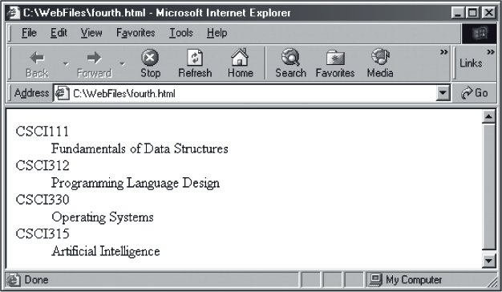
21.5 Lists
Figure 21-5 shows the page resulting from this HTML segment:

Slide 179
21.5 Lists
A Nested List Example:
<UL>
<LI>Fundamentals of Data Structures
<!--The nested, numbered list begins here. -->
<OL>
<LI>Analysis of algorithms
<LI>Collections
<LI>Linked lists
<LI>Stacks
<LI>Queues
<LI>Recursion
<LI>Binary search trees
</OL>
<!--The nested list ends here. -->
<LI>Programming Language Design
<LI>Operating Systems
<LI>Artificial Intelligence
</UL>

Slide 180
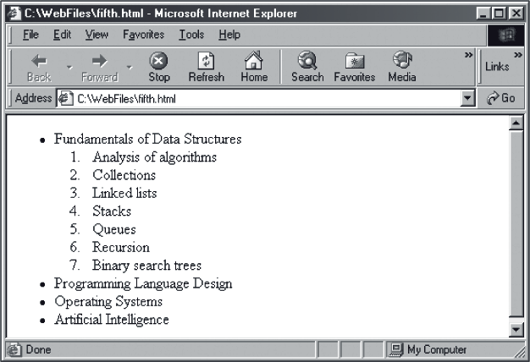
21.5 Lists
Figure 21-6 shows the page resulting from this HTML segment.

Slide 181
21.6 Linking to Other Documents
Links, also called hyperlinks or hypertext references, allow readers to move to other pages in the Web.
The markup tag for a link is <A>, which stands for anchor.

Slide 182
21.6 Linking to Other Documents
Placing a link in an HTML document involves the following steps:
Identify the target document that will be at the other end of the link. This identifier should be a pathname or a URL (see the discussion in the next subsection).
Determine the text that labels the link in the browser.
Place this information within an anchor, using the following format:
<A HREF=target document identifier>text of link</A>

Slide 183
21.6 Linking to Other Documents
The following segment displays a link to the file courses.html in a sentence that mentions the author’s courses:
When the user browses this page, the link is highlighted in some fashion (i.e., a different color text) and usually underlined, as in Figure 21-7.
<P>
My <A HREF="courses.html">courses last year</A> were Fundamentals of Data Structures, Programming Language Design, Operating Systems, and Artificial Intelligence.
</P>

Slide 184
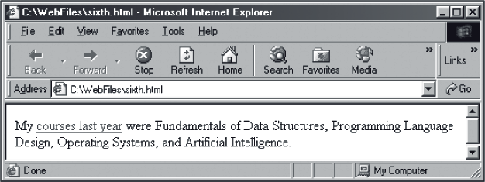
21.5 Lists

Slide 185
21.6 Linking to Other Documents
Path Names
The path name specifies the path to the file on the author’s computer.
The path name is said to be absolute because it specifies the exact or absolute position of the file in the computer’s directory structure.
In HTML anchors, we can use absolute or relative path names to specify the location of a target document.
Table 21-4 shows some examples of the relative path name to MyPage.html.

Slide 186
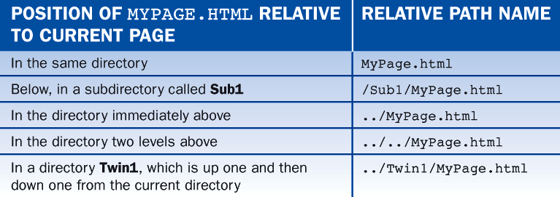
21.6 Linking to Other Documents

Slide 187
21.6 Linking to Other Documents
URLs
When a target document resides on another server in the network, a path name no longer suffices to locate the document.
We use a uniform resource locator (URL) to locate the document on another machine.

Slide 188
21.6 Linking to Other Documents
A URL to another Web site (called a host) has the following format:
For instance, the URL for author Ken Lambert’s home page is:
http://server name/document path name
<A HREF="http://www.wlu.edu/~lambertk">Ken Lambert</A>

Slide 189
21.7 Multimedia
HTML supports the presentation of non-textual information such as images, sounds, and movies.
Inline images are graphical images that are displayed when the user opens a page.
The form of the markup tag for an inline image is:
<IMG SRC=ImageLocation>
ImageLocation is a URL or path name.
Images can be encoded in the GIF or JPEG format and are stored in files whose extensions are:
.gif
.jpg
.jpeg

Slide 190
21.7 Multimedia
Several parameters can be used with the markup tag of an inline image:
Size attributes:
Specify the height and width of the image in pixels.
<IMG SRC="mypicture.gif" HEIGHT=100 WIDTH=100>
Alignment attribute:
Specifies the position of text relative to the image. By default, text that follows an image starts at the image's lower right corner. The text moves to the top right or to the center right of the image when TOP or CENTER are specified.
<IMG SRC="mypicture.gif" ALIGN=CENTER>

Slide 191
21.7 Multimedia
To detach an image from surrounding text, place the image in a separate paragraph. For instance:
<p ALIGN=CENTER>
<IMG SRC="mypicture.gif">
</p>

Slide 192
21.7 Multimedia
External Images:
Inline images increase a document’s size and slow its transfer across the Net.
For that reason, documents sometimes provide links to external images, which are not displayed until the user clicks on a link.

Slide 193
21.7 Multimedia
External Images:
The following HTML segment shows two ways of linking to an external image:
The first link is a string of text.
The second link is a smaller version of the image (sometimes called a thumbnail).
<A HREF="mypicture.gif">Sample picture</A>
<A HREF="mypicture.gif"><IMG SRC="mythumbnail.gif"</A>

Slide 194
21.7 Multimedia
Colors and Backgrounds
Background, text, and link colors are controlled by the BGCOLOR, TEXT, and LINK attributes of the BODY tag.
The following tag sets the background to black, text to white, and links to red:
<BODY BGCOLOR="#000000" TEXT="#FFFFFF" LINK="#FF0000">

Slide 195
21.7 Multimedia
Another way to customize a background is to display an image on it.
If the image is small, the browser fills the window with the image by a process called tiling, which repeatedly displays the image across and down the screen, thus creating a wallpaper-like effect.
The following tag shows how to use an image as a background:
<BODY BACKGROUND="mybackground.jpg">

Slide 196
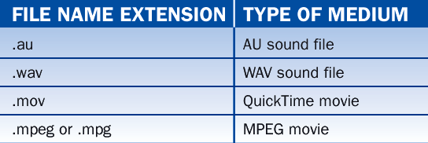
21.7 Multimedia
Other Media
Table 21-5 shows file name extensions for some typical media used in HTML documents.

Slide 197
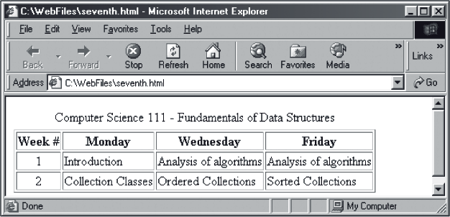
21.8 Tables
The page in Figure 21-8 uses to table to display the first two weeks of topics in a data structures course.

Slide 198
21.8 Tables
Tables usually contain the following elements:
A caption or title, normally at the top of the table.
A first row containing column headers. Each header describes the kind of data contained in the column beneath it.
Several rows of data. The cells in a row can contain any HTML elements (text, images, links, etc.).

Slide 199
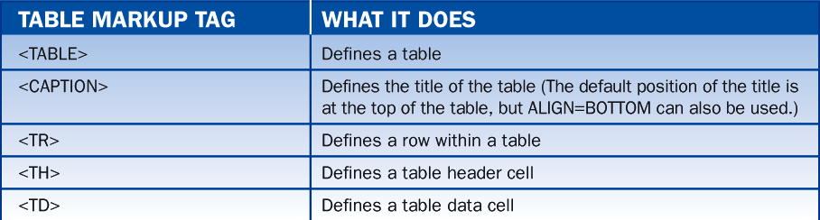
21.8 Tables
Table 21-6 provides a list of the HTML markup tags used with tables:

Slide 200

21.8 Tables
The table markup tags accept the attributes shown in Table 21-7.
Cell attributes override row attributes, and row attributes override table attributes.

Slide 201
21.8 Tables
Typical Table Format
The blank lines between rows increase readability but do not affect the manner in which the table is displayed:

Slide 202
21.8 Tables
<TABLE>
<CAPTION> title of the table </CAPTION>
<TR>
<TH> header of first column </TH>
.
.
<TH> header of last column </TH>
</TR>
<TR>
<TD> contents of first data cell </TD>
.
.
<TD> contents of last data cell </TD>
</TR>
.
.
<TR>
<TR>
<TD> contents of first data cell </TD>
.
.
<TD> contents of last data cell </TD>
</TR>
</TABLE>

Slide 203
21.9 Applets
An applet is a Java application that runs in a Web page.
Two components are needed to run an applet:
An HTML document that contains an applet markup tag.
A byte code file for the applet - that is, a compiled Java applet in a .class file.
An applet markup tag has the following form:
<APPLET CODE=byte code file name
WIDTH=width HEIGHT=height></APPLET>
The width and height are the width and height, respectively, of the applet's screen area in pixels.

Slide 204

21.9 Applets
The Fahrenheit/Celsius converter might appear in a Web page as shown in Figure 21-9:

Slide 205
21.9 Applets
Following is the HTML code for the example:
<html>
<head>
<TITLE>Fahrenheit/Celsius Converter</TITLE>
</head>
<body>
<UL>
<LI>Enter degrees Fahrenheit or degrees Celsius.
<LI>Click the <STRONG><<<<<<</STRONG> button and the
Fahrenheit equivalent will be displayed.
<LI>Click the <STRONG>>>>>>></STRONG> button and the
Celsius equivalent will be displayed.
</UL>

Slide 206
21.9 Applets
<APPLET CODE="ConvertWithGUI.class" WIDTH=250 HEIGHT=100>
</APPLET>
<P>
Applets greatly increase the power of the Web.
<body>
</html>

Slide 207
21.9 Applets
Converting an Application to an Applet
To convert Java applications to applets, we must do four things:
Replace the name GBFrame with the name GBApplet at the beginning of the class definition.
Delete the method main.
Eliminate any use of the setTitle method.
Replace the constructor, if any, by the method init:
public void init(){
...
}

Slide 208
21.9 Applets
Using the Applet Viewer
Sun's JDK comes with a tool called an applet viewer.
This tool allows the programmer to run an applet and view just its GUI, without the surrounding Web page.
To use the applet viewer, you must:
Compile the Java source program as usual.
Create an HTML file with at least the minimal applet tag for the applet.
At the command line prompt, run the command:
appletviewer <html file name>

Slide 209

21.9 Applets
Figure 21-10 shows the converter applet running within the applet viewer.

Slide 210
21.9 Applets
Passing Parameters to Applets
It is possible to send information from an HTML page to an applet.
In the following example, a parameter tag binds the string "5" to the name "numberOfCourses."
The parameter tag must appear between the opening and closing applet tag:
<APPLET CODE="Courses.class" WIDTH=150 HEIGHT=100>
<PARAM NAME=numberOfCourses VALUE="5">
</APPLET>

Slide 211
21.9 Applets
At any point within the applet, the method getParameter can retrieve the parameter's value, but always as a string:
A common location for such code is in the init method.
If there are several parameters, each requires its own tag.
String str = getParameter ("numberOfCourses");
int num = (new Integer(str)).intValue();

Slide 212
Lesson 22: Swing and AWT

Slide 213
Lesson 22: Swing and AWT
Objectives:
Understand how to structure a GUI-based program using Java's Swing and AWT packages.
Give an overview of the Swing component classes.
Distinguish container classes, such as frames and panels, from other component classes.
Distinguish the various layout managers and choose the appropriate one for organizing components.

Slide 214
Lesson 22: Swing and AWT
Objectives:
Define listener classes to handle events associated with components.
Know how to attach listener objects to components.
Apply the model/view/controller pattern to the design of a program.
Create user interfaces for dialogs and applets as well as applications.

Slide 215
Lesson 22: Swing and AWT
Vocabulary:
Abstract Windowing Toolkit (AWT)
adapter class
component
container
grid bag layout
listener
modal
model/view/controller pattern
option panes
scroll bar
slider
Swing

Slide 216
22.1 The Swing and AWT Philosophy
Applications with a graphical user interface are based ultimately on Java’s Abstract Windowing Toolkit (AWT) and Swing toolkit.
The toolkits are abstract in two senses:
They provide classes and methods that are platform independent. Write once, run anywhere.
They create user interfaces whose look and feel are platform independent. Run anywhere, look similar.
Applications that use Swing and AWT involve the use of four categories of classes.
Table 22-1 briefly describes each category.

Slide 217

22.1 The Swing and AWT Philosophy

Slide 218
22.1 The Swing and AWT Philosophy
We use these classes to define a graphical user interface as follows:
Add window objects to the interface under the control of a layout manager.
Decide which events each object should handle by adding listeners for the event to the object.

Slide 219
22.2 Conversion Program Implemented with GBFrame
Figure 22-1 shows a version of the following program implemented with GBFrame:
/* ConvertWithGUI.java
A GUI-based temperature conversion program that coverts from
Fahrenheit to Celsius and vice versa.
*/
import javax.swing.*;
import BreezySwing.*;
public class ConvertWithGUI extends GBFrame{
// Declare variables for the window objects.
private JLabel fahrenheitLabel;
private JLabel celsiusLabel;
private DoubleField fahrenheitField;
private DoubleField celsiusField;
private JButton fahrenheitButton;
private JButton celsiusButton;

Slide 220
22.2 Conversion Program Implemented with GBFrame
// Constructor
public ConvertWithGUI(){
// Instantiate and add window objects to the window.
fahrenheitLabel = addLabel ("Fahrenheit" ,1,1,1,1);
celsiusLabel = addLabel ("Celsius" ,1,2,1,1);
fahrenheitField = addDoubleField (32.0 ,2,1,1,1);
celsiusField = addDoubleField (0.0 ,2,2,1,1);
fahrenheitButton = addButton (">>>>>>" ,3,1,1,1);
celsiusButton = addButton ("<<<<<<" ,3,2,1,1);
}
// Respond to button click events
public void buttonClicked (JButton buttonObj){
// Local variables
Thermometer thermo = new Thermometer();
// Determine which button was clicked.
if (buttonObj == fahrenheitButton){

Slide 221
22.2 Conversion Program Implemented with GBFrame
// Convert from Fahrenheit to Celsius
thermo.setFahrenheit(fahrenheitField.getNumber());
celsiusField.setNumber (thermo.getCelsius());
}else{
// Convert Celsius to Fahrenheit
thermo.setCelsius(celsiusField.getNumber());
fahrenheitField.setNumber (thermo.getFahrenheit());
}
}
// Execution begins in the method main as usual.
public static void main (String[] args){
ConvertWithGUI theGUI = new ConvertWithGUI();
theGUI.setSize (250, 100); //Set the window's size in pixels
// width = 250, height = 100
theGUI.setVisible (true); //Make the window visible
}
}

Slide 222
22.3 Conversion Program Implemented with Swing & AWT
Let's look at the program implemented using Swing and AWT without GBFrame.
The program is spread out over four files that are listed in Table 22-2.
As you will see, the difference between writing a GUI application with and without GBFrame is dramatic.

Slide 223

22.3 Conversion Program Implemented with Swing & AWT

Slide 224

22.3 Conversion Program Implemented with Swing & AWT
The Interface
The interface (Figure 22-2) appears essentially the same as it did earlier when we used GBFrame.
The cause of the minor differences will become clear when we discuss layout managers.

Slide 225
22.3 Conversion Program Implemented with Swing & AWT
The File ConversionWithSwing.java
Begin by importing the swing package:
Because we are now dealing directly with layouts and listeners, we also import the awt package:
import javax.swing.*;
import java.awt.*;

Slide 226
22.3 Conversion Program Implemented with Swing & AWT
We then extend JFrame rather than GBFrame:
The variables that reference the window objects are declared next:
public class ConversionWithSwing extends JFrame {
private JLabel fahrenheitLabel;
private JTextField fahrenheitField;

Slide 227
22.3 Conversion Program Implemented with Swing & AWT
Swing/AWT has no integer fields, so in the preceding line, we use a text field instead.
There are a number of tasks that must be performed in the constructor:
private JLabel celsiusLabel;
private JTextField celsiusField;
private JButton fahrenheitButton;
private JButton celsiusButton;
public ConversionWithSwing(){

Slide 228
22.3 Conversion Program Implemented with Swing & AWT
First, instantiate the window objects:
fahrenheitLabel = new JLabel ("Fahrenheit");
fahrenheitField = new JTextField ("212", 6); // 6 columns wide
celsiusLabel = new JLabel ("Celsius");
celsiusField = new JTextField ("100", 6); // 6 columns wide
fahrenheitButton = new JButton (">>>>>>");
celsiusButton = new JButton ("<<<<<<");

Slide 229
22.3 Conversion Program Implemented with Swing & AWT
Second, before adding and positioning window objects, we must instantiate the layout:
Third, we must get the frame's content pane and set its layout:
FlowLayout layout = new FlowLayout();
Container mainWindow = getContentPane();
mainWindow.setLayout (layout);

Slide 230
22.3 Conversion Program Implemented with Swing & AWT
Fourth, we add the window objects under the influence of the layout, which controls their actual placement.
mainWindow.add (fahrenheitLabel);
mainWindow.add (celsiusLabel);
mainWindow.add (fahrenheitField);
mainWindow.add (celsiusField);
mainWindow.add (fahrenheitButton);
mainWindow.add (celsiusButton);

Slide 231
22.3 Conversion Program Implemented with Swing & AWT
Fifth, it is necessary to tell the buttons where their listener code is located.
Sixth, a listener is needed to close the window.
fahrenheitButton.addActionListener
(new FahrenheitButtonListener (this));
celsiusButton.addActionListener
(new CelsiusButtonListener (this));
addWindowListener (new GenericWindowListener());
}

Slide 232
22.3 Conversion Program Implemented with Swing & AWT
The conversion from Celsius to Fahrenheit is done in the method that follows.
The conversions between strings and numbers are necessary because Swing/AWT does not include the numeric fields that are part of GBFrame and GBApplet.
Instead, we must use the Swing's JTextField.

Slide 233
22.3 Conversion Program Implemented with Swing & AWT
public void computeFahrenheit(){
Thermometer thermo = new Thermometer();
String str = celsiusField.getText().trim();
double celsius = (new Double(str)).doubleValue();
thermo.setCelsius(celsius);
double fahrenheit = thermo.getFahrenheit();
fahrenheitField.setText ("" + fahrenheit);
}

Slide 234
22.3 Conversion Program Implemented with Swing & AWT
The conversion from Fahrenheit to Celsius is handled by the next method. It is similar to the preceding one.
public void computeCelsius(){
Thermometer thermo = new Thermometer();
String str = fahrenheitField.getText().trim();
double fahrenheit = (new Double(str)).doubleValue();
thermo.setFahrenheit(fahrenheit);
double celsius = thermo.getCelsius();
celsiusField.setText ("" + celsius);
}

Slide 235
22.3 Conversion Program Implemented with Swing & AWT
The method main is similar, but the window is made a bit narrower:
That ends the code for ConversionWithSwing.java.
public static void main (String[] args){
JFrame frm = new ConversionWithSwing();
frm.setSize (150, 150);
frm.setVisible (true);
}
}

Slide 236
22.4 Variations on Implementing with Swing and AWT
Simplifying the GenericWindowListener Class
The need to include the empty methods can be avoided if the GenericWindowListener extends the WindowAdapter class instead of implementing the WindowListener interface.
The WindowAdapter class is part of the package java.awt.event.

Slide 237
22.4 Variations on Implementing with Swing and AWT
public abstract class WindowAdapter implements WindowListener {
public void windowOpened(WindowEvent e) {}
public void windowClosing(WindowEvent e) {}
public void windowClosed(WindowEvent e) {}
public void windowIconified(WindowEvent e) {}
public void windowDeiconified(WindowEvent e) {}
public void windowActivated(WindowEvent e) {}
public void windowDeactivated(WindowEvent e) {}
}

Slide 238
22.4 Variations on Implementing with Swing and AWT
The WindowAdapter class belongs to a category of classes known as adapter classes.
An adapter class implements an interface by providing stub methods.
Clients then can avoid implementing all the methods in an interface by extending the corresponding adapter class.
Following is the GenericWindowListener written as an extension of the WindowAdapter class.
Only one method now needs to be implemented.

Slide 239
22.4 Variations on Implementing with Swing and AWT
import java.awt.event.*;
public class GenericWindowListener extends WindowAdapter{
public void windowClosing (WindowEvent e){
System.exit(0);
}
}

Slide 240
22.4 Variations on Implementing with Swing and AWT
Altogether there are 11 listener interfaces in AWT.
Listeners with more than one method have a corresponding adapter, thus providing programmers with the convenience of extending the adapter rather than implementing the interface.

Slide 241
22.5 GUI Components
The first category of classes used in developing windows-based applications is the GUI components.
The visible objects that constitute a window fall into this category.
These objects include:
Buttons
text fields
text areas
Lists
menu items
and so forth

Slide 242
22.5 GUI Components
The Component Class Hierarchy
All of the GUI component classes, whether in Swing or AWT, are subclasses of an abstract class in AWT called Component.
This class specifies the most basic attributes and behavior of all GUI objects.
Every component has attributes that define its:
size (width and height in pixels)
background color
foreground color
text font
and visibility.

Slide 243

22.5 GUI Components
Commonly used methods for modifying these attributes are shown in Table 22-3.

Slide 244

22.5 GUI Components
Figure 22-3 shows a portion of the Swing branch of the Component class hierarchy.

Slide 245
22.5 GUI Components
Note the following points about the figure:
The two classes at the top of the hierarchy are in java.awt, whereas the rest of the classes are in javax.swing.
The concrete classes are shaded, whereas the abstract classes are not.

Slide 246
22.5 GUI Components
Panels
JPanel is the parent class of the BreezySwing class GBPanel.
A panel represents a rectangular area within a window.
This area can be painted and repainted independently of the rest of the window.

Slide 247
22.5 GUI Components
Scroll Bars
To add scroll bars to a list box or text area, you must wrap an instance of JScrollPane around it, as shown in the following code segment:
Container c = getContentPane();
TextArea ta = new JTextArea(); // Create a text area
c.add(new JScrollPane(ta)); // Wrap it in scroll bars and add to GUI

Slide 248
22.5 GUI Components
Sliders
A slider is used to enter an input value, usually a number, by dragging the mouse along a ticked ruler.
Sliders are instances of the class JSlider.

Slide 249
22.5 GUI Components
Menu Components
The following code segment uses BreezySwing to set up a File menu and an Edit menu with appropriate options:
JMenuItem newFileItem = addMenuItem("File", "New");
JMenuItem openFileItem = addMenuItem("File", "Open");
JMenuItem saveFileItem = addMenuItem("File", "Save");
JMenuItem cutEditItem = addMenuItem("Edit", "Cut");
JMenuItem copyEditItem = addMenuItem("Edit", "Copy");
JMenuItem pasteEditItem = addMenuItem("Edit", "Paste");

Slide 250
22.5 GUI Components
Option Panes
Option panes provide a set of commonly used dialogs, such as:
Prompters
message boxes
and confirmation dialogs.
They are created by sending messages to the class JOptionPane.
Table 22-4 lists some typical messages:

Slide 251

22.5 GUI Components

Slide 252
22.5 GUI Components
There are several variations of each method that allow the client to specify the title, the type of message (error, warning, etc.), and so forth.
The following code segment shows the use of a confirmation dialog:
int choice = JOptionPane.showConfirmDialog(this, "Want to quit?");
if (choice == JOptionPane.YES_OPTION)
System.out.println("Yes");
else if (choice == JOptionPane.NO_OPTION)
System.out.println("No");
else if (choice == JOptionPane.CANCEL_OPTION)
System.out.println("Cancel");

Slide 253
22.5 GUI Components
Container Classes
Container objects are so called because they contain other window objects, including other containers.
A container must use a layout manager that determines the arrangement of the components within it.
Figure 22-4 shows Swing's primary container classes, and Table 22-5 describes their uses.

Slide 254

22.5 GUI Components

Slide 255

22.5 GUI Components

Slide 256
22.6 Layouts
Components in a Java window distribute themselves to fill the available space.
The exact manner of this distribution depends on what is called the window's layout, as defined by one of Java's layout manager classes.
Table 22-6 lists the layout manager classes with an illustration and overview of each.

Slide 257

22.6 Layouts

Slide 258

22.6 Layouts
Border Layouts
The default layout for frames and dialogs is BorderLayout.
The layout of Figure 22-5 divides a container into five regions:

Slide 259

22.6 Layouts
Not all regions need to be present.
If the Center region is omitted, it leaves an empty space in the container; however, if any of the other regions are omitted, the central region expands to fill the vacated space (Figure 22-6).

Slide 260
22.6 Layouts
A component is added to a region using the add method:
add (<component>, <region>)
Where <region> is one of the strings
"North“
"South“
"East“
"West“
and "Center".

Slide 261
22.6 Layouts
The following code segment creates the border layout shown in Figure 22-5, which includes all five regions.
// Create and set the layout
BorderLayout layout = new BorderLayout();
Container mainWindow = getContentPane();
mainWindow.setLayout (layout);
// Add components under control of the layout
mainWindow.add (new JButton("North"), "North");
mainWindow.add (new JButton("East"), "East");
mainWindow.add (new JButton("South"), "South");
mainWindow.add (new JButton("West"), "West");
mainWindow.add (new JButton("Center"), "Center");

Slide 262

22.6 Layouts
Flow Layouts
The default window layout for panels and applets is FlowLayout.
A flow layout displays components in horizontal lines in the order in which they are added.
Components that do not fit on a line wrap around onto the next (Figure 22-7).

Slide 263

22.6 Layouts
When a user resizes a window, the wrapping points shift, and the appearance of the window changes dramatically.
For instance, the two windows in Figure 22-8 were created by the same program.

Slide 264
22.6 Layouts
By default, a flow layout centers the components in each row and separates them horizontally and vertically by five pixels.
The flow layout shown in Figure 22-7 can be created as follows:
FlowLayout layout = new FlowLayout();
Container mainWindow = getContentPane();
mainWindow.setLayout (layout);
mainWindow.add (new JButton("One"));
mainWindow.add (new JButton("Two"));
mainWindow.add (new JButton("Three"));
mainWindow.add (new JButton("Four"));

Slide 265
22.6 Layouts
One can align the components to the left, center, or right using the constants:
FlowLayout.LEFT
FlowLayout.CENTER
FlowLayout.RIGHT
To align the components at the left (Figure 22-9), the programmer writes
FlowLayout layout = new FlowLayout (FlowLayout.LEFT);
Container mainWindow = getContentPane();
mainWindow.setLayout (layout);
// Now add the components

Slide 266

22.6 Layouts

Slide 267

22.6 Layouts
The following example centers window objects with horizontal gaps of 10 and vertical gaps of 15 pixels (see Figure 22-10):
FlowLayout layout = new FlowLayout (FlowLayout.CENTER, 10, 15);
Container mainWindow = getContentPane();
mainWindow.setLayout (layout);
// Now add the components

Slide 268

22.6 Layouts
Grid Layouts
A regular pattern of objects, such as a table of buttons, is easily displayed with a grid layout.

Slide 269
22.6 Layouts
Grid Bag Layouts
The grid bag layout is the most versatile and most complex layout manager.
It treats the display area as a grid of cells.
The grid begins with no cells and adds cells as needed to accommodate the components.
Components occupy rectangular blocks of cells called display areas.
Cells can be empty, and their size can vary.

Slide 270

22.6 Layouts
In Figure 22-12, a grid has been superimposed on the window.
The button One occupies two cells.
Each of the other buttons occupies a single cell.
The remaining cells are empty.

Slide 271

22.6 Layouts
The public instance variables are described in Table 22-7.

Slide 272

22.6 Layouts

Slide 273

22.6 Layouts

Slide 274

22.6 Layouts
Card Layouts
A card layout consists of a stack of components.
Only one component can be seen at a time, but it is possible to switch between components.
When a card layout is created, the top component is visible.
Figure 22-13 illustrates a card layout.

Slide 275

22.6 Layouts
Panels
A panel is a container that can contain other components, including other panels.
Fancy graphical user interfaces
can be built by
combining panels
and other
components in
an imaginative
manner.

Slide 276
22.6 Layouts
Events and Components
We know that certain events can be associated with certain components.
For instance, the action event can be associated with buttons, and keyboard events can be associated with text fields.
Table 22-8 lists:
three different classes of events
their associated components
the conditions that trigger the events.

Slide 277
22.6 Layouts
For example, the table indicates that the ActionEvent:
is limited to:
Buttons
Lists
menu items
and text fields.
can be triggered by:
clicking a button
double clicking an item in a list
selecting a menu item
or pressing the Enter key in a text field.

Slide 278

22.7 Events

Slide 279

22.7 Events

Slide 280
22.7 Events
Events and Listeners
An event is ignored unless the originating component has added a listener to handle the event.
Table 22-9 lists some events in AWT, their associated listeners, and how to add/remove these listeners.
Table 22-7 also lists the methods included in each listener interface.

Slide 281

22.7 Events

Slide 282

22.7 Events

Slide 283
22.7 Events
Events and Their Methods
Table 22-10 lists several different classes of events and the most useful methods in each class:

Slide 284

22.7 Events

Slide 285
22.8 Dialogs
Dialogs are like frames in many ways, but with two important exceptions:
A dialog can be modal:
it can prevent the user from accessing the rest of the application before quitting the dialog
A dialog must have a parent - that is, a frame to which it can refer after it is created.
A dialog can also have a title.

Slide 286
22.8 Dialogs
There are several constructors that allow the programmer to specify these attributes:
public JDialog (JFrame parent, String title, boolean modal)
public JDialog (JFrame parent, String title)
public JDialog (JFrame parent, boolean modal)
public JDialog (JFrame parent)

Slide 287

22.8 Dialogs
The programmer must use Swing and AWT to lay out a dialog's window objects and set up their listeners just as with frames.
To show how this is done, we redo the dialog example presented in Lesson 10.
The interface of
the revised
dialog is shown
in Figure 22-15.

Slide 288
22.8 Dialogs
Following is the portion of the of the application's main interface class that involves the use of the dialog.
private void add(){
//Adds a new student.
// Preconditions -- none
// Postconditions -- if the user cancels the dialog, then no change
// -- else the new student is selected
// she is added to the end of the student list
// her name is added to the end of the name list
// her info is displayed
// she becomes the selected item in both lists
Student tempStu = new Student();
StudentDialog studentDialog
= new StudentDialog (this, tempStu);

Slide 289
22.8 Dialogs
studentDialog.show();
if (studentDialog.getDlgCloseIndicator().equals ("OK")){
String message = model.add (tempStu);
if (message != null){
messageBox(message);
return;
}
model.setCurrentStudent(tempStu.getName());
displayCurrentStudent();
}
}

Slide 290
22.8 Dialogs
Below is a listing of the revised dialog class:
We use Swing and AWT directly.
/* StudentDialog.java
1) This is the dialog for the student test scores program.
2) It displays the student passed to it.
3) The user can then change the data in the dialog's window.
4) If the user clicks the OK button, the student is updated with
the data in the window.
5) If the user clicks the Cancel button, the dialog closes and returns
without modifying the student.
*/
import javax.swing.*;
import java.awt.*;
import java.awt.event.*;
public class StudentDialog extends JDialog
implements ActionListener{

Slide 291
22.8 Dialogs
//Window objects
private JLabel nameLabel, test1Label, test2Label, test3Label;
private JTextField nameField, test1Field, test2Field, test3Field;
private JButton btnOK, btnCancel;
//Instance variables
private Student student; //The student being modified
private String closeIndicator; //The dialog close indicator
public StudentDialog (JFrame f, Student stu){
//Constructor
// Preconditions -- the input parameters are not null

Slide 292
22.8 Dialogs
// Postconditions -- the dialog's window is initialized
// -- the student variable is set
// -- the student's data are displayed in the
// dialog's window
//Housekeeping required in every modal dialog
super (f, true);
//Set the dialog's size and title
setSize (250,150);
setTitle ("Student Dialog");
//Set the dialog's default value for the close indicator to Cancel.
//If the user closes the dialog without clicking either the OK or
//Cancel button, the default takes effect.
setDlgCloseIndicator ("Cancel");

Slide 293
22.8 Dialogs
//Save the student reference and display the student data in the
//dialog's window.
student = stu;
// Instantiate the window objects
nameLabel = new JLabel("Name");
test1Label = new JLabel("Test 1");
test2Label = new JLabel("Test 2");
test3Label = new JLabel("Test 3");
nameField = new JTextField(12);
test1Field = new JTextField(3);
test2Field = new JTextField(3);
test3Field = new JTextField(3);
btnOK = new JButton("OK");
btnCancel = new JButton("Cancel");

Slide 294
22.8 Dialogs
// Add the window objects to the appropriate layout
JPanel labelPanel = new JPanel(new GridLayout(4, 1));
JPanel fieldPanel = new JPanel(new GridLayout(4, 1));
JPanel buttonPanel = new JPanel();
Container mainWindow = getContentPane();
mainWindow.add("West", labelPanel);
mainWindow.add("East", fieldPanel);
mainWindow.add("South", buttonPanel);
labelPanel.add(nameLabel);
labelPanel.add(test1Label);
labelPanel.add(test2Label);
labelPanel.add(test3Label);
fieldPanel.add(nameField);
fieldPanel.add(test1Field);
fieldPanel.add(test2Field);
fieldPanel.add(test3Field);
buttonPanel.add(btnOK);
buttonPanel.add(btnCancel);

Slide 295
22.8 Dialogs
// Add the action listeners to the buttons
btnOK.addActionListener(this);
btnCancel.addActionListener(this);
// Display the student's information
nameField.setText (student.getName());
test1Field.setText("" + student.getScore(1));
test2Field.setText("" + student.getScore(2));
test3Field.setText("" + student.getScore(3));
}

Slide 296
22.8 Dialogs
public void actionPerformed (ActionEvent e){
//Responds to the OK and Cancel buttons.
// Preconditions -- one of the two buttons has been clicked
// Postconditions -- if the Cancel button then
// the student is not modified
// the close indicator equals Cancel
// the dialog is closed
// control returns to the caller
// -- if the OK button then
// the student is modified
// the close indicator equals OK
// the dialog is closed
// control returns to the caller

Slide 297
22.8 Dialogs
//Get the data from the screen
String name = nameField.getText();
int score1 = new Integer(test1Field.getText()).intValue();
int score2 = new Integer(test2Field.getText()).intValue();
int score3 = new Integer(test3Field.getText()).intValue();
String validationErrors;
// Get the button in which the click occurred
JButton buttonObj = (JButton) e.getSource();
if (buttonObj == btnCancel) //Cancel button
//Close the dialog and return to the caller
dispose();
else{ //OK button

Slide 298
22.8 Dialogs
//Update the student with the screen data
student.setName(name);
student.setScore(1, score1);
student.setScore(2, score2);
student.setScore(3, score3);
//Set the close indicator to OK, close the dialog, and
//return to the caller.
setDlgCloseIndicator ("OK");
dispose();
}
}
public void setDlgCloseIndicator(String s){
closeIndicator = s;
}
public String getDlgCloseIndicator(){
return closeIndicator;
}
}

Slide 299
22.8 Dialogs
The critical code to notice in the main interface class is:
StudentDialog studentDialog
= new StudentDialog (this, tempStu);
studentDialog.show();
if (studentDialog.getDlgCloseIndicator().equals ("OK")){
String message = model.add (tempStu);
if (message != null){
messageBox(message);
return;
}
model.setCurrentStudent(tempStu.getName());
displayCurrentStudent();
}

Slide 300
22.9 The Model/View/Controller Pattern
In the model/view/controller pattern, also called the MVC pattern, it is the view's responsibility to:
instantiate the window objects, position them in the interface, and attach listeners to them as needed
instantiate and initialize the model
accurately represent the model to the user

Slide 301
22.9 The Model/View/Controller Pattern
The responsibilities of the model are to:
define and manage the application's data (this usually requires coordinating the activities of several programmer-defined classes)
respond to messages from the listeners
inform the view of changes to the model's internal state
The responsibilities of controller are to:
implement the necessary listeners.
send messages to the model in response to user-generated events

Slide 302
22.10 Applets, Swing, and AWT
To illustrate the conversion process, here is the second version of the ConversionWithSwing program from the beginning of the lesson rewritten as an applet:
import javax.swing.*;
import java.awt.*;
import java.awt.event.*;
public class ConversionWithSwing extends JApplet
implements ActionListener{
private JLabel fahrenheitLabel;
private JTextField fahrenheitField;
private JLabel celsiusLabel;
private JTextField celsiusField;
private JButton fahrenheitButton;
private JButton celsiusButton;

Slide 303
22.10 Applets, Swing, and AWT
public void init(){
fahrenheitLabel = new JLabel ("Fahrenheit");
fahrenheitField = new JTextField ("212", 6); // 6 columns wide
celsiusLabel = new JLabel ("Celsius");
celsiusField = new JTextField ("100", 6); // 6 columns wide
fahrenheitButton = new JButton (">>>>>>");
celsiusButton = new JButton ("<<<<<<");
Container mainWindow = getContentPane();
mainWindow.setLayout(new FlowLayout());
mainWindow.add (fahrenheitLabel);
mainWindow.add (celsiusLabel);
mainWindow.add (fahrenheitField);
mainWindow.add (celsiusField);
mainWindow.add (fahrenheitButton);
mainWindow.add (celsiusButton);
fahrenheitButton.addActionListener (this);
celsiusButton.addActionListener (this);
}

Slide 304
22.10 Applets, Swing, and AWT
public void actionPerformed (ActionEvent e){
String str;
double fahrenheit, celsius;
JButton btn = (JButton)e.getSource();
Thermometer thermo = new Thermometer();
if (btn == celsiusButton){
str = celsiusField.getText().trim();
celsius = (new Double (str)).doubleValue();
thermo.setCelsius(celsius);
fahrenheit = thermo.getFahrenheit();
fahrenheitField.setText ("" + fahrenheit);
}
else{
str = fahrenheitField.getText().trim();
fahrenheit = (new Double (str)). doubleValue ();
thermo.setFahrenheit(fahrenheit);
celsius = thermo.getCelsius();
celsiusField.setText ("" + celsius);
}
}
}

Slide 305
22.11 Setting the Look and Feel
The programmer can set the look and feel of a GUI-based program written with Swing.
Following is the code for the method, which you can place in any subclass of JFrame, JDialog, or JApplet as well:

Slide 306
22.11 Setting the Look and Feel
public void setLookAndFeel(String type){
int value = 0;
UIManager.LookAndFeelInfo[] looks;
looks = UIManager.getInstalledLookAndFeels();
if (type.equalsIgnoreCase("METAL"))
value = 0;
else if (type.equalsIgnoreCase("MOTIF"))
value = 1;
else
value = 2;
try{
UIManager.setLookAndFeel(looks[value].getClassName());
SwingUtilities.updateComponentTreeUI(this);
}catch(Exception e){
messageBox("Error: \n" + e.toString());
}
}

